Slide 1
Soil Erosion and Torrential Flood Prevention: Curriculum Development at the Universities of Western Balkan Countries
Presentation of the SETOF project
Project coordinator
University of Belgrade
Notes:
dear colleagues, dear guests, it is my great pleasure to present the project
University of Belgrade Faculty of Forestry Team in cooperation with all project partners started preparing project proposal at the end of November 2016. Unfortunately, in the 2017 project proposal has been not selected for EU co-funding. But, we tried again and revised the first proposal according to the suggestions of the reviewers.

Slide 2
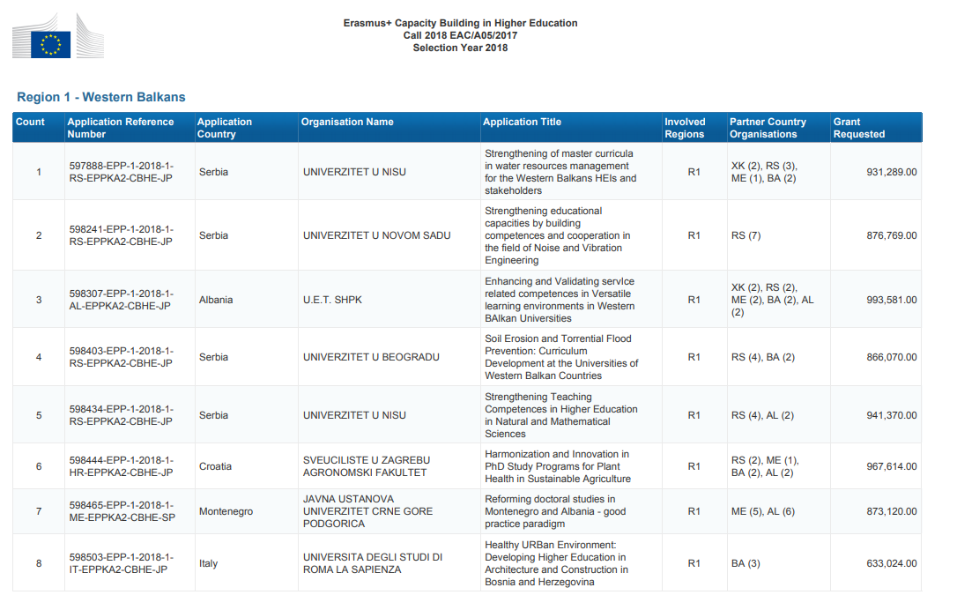
Notes:
The good News are that our SETOF project was selected for EU co-funding on August 7, 2018.

Slide 3
Project title: Soil Erosion and Torrential Flood Prevention: Curriculum Development at the Universities of Western Balkan Countries
Project acronym: SETOF
Reference Number: 598403-EPP-1-2018-1-RS-EPPKA2-CBHE-JP
Programme: Erasmus +
Key Action: Cooperation for innovation and the exchange of good practice
Action: Capacity Building in Higher Education
Action Type: Joint Projects
Call for Proposals: Call 2018 EAC/A05/2017
Duration of the project: 3 years
Start : 15.11.2018
Budget of the project: 865.070,00 EUR
Notes:
This slide shows basic project data, such as
Budget of the project that is estimated to be

Slide 4
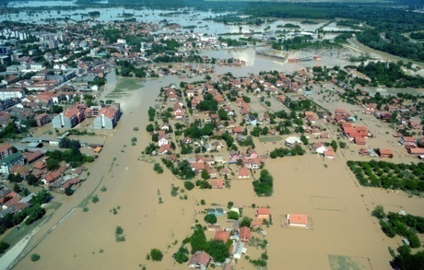
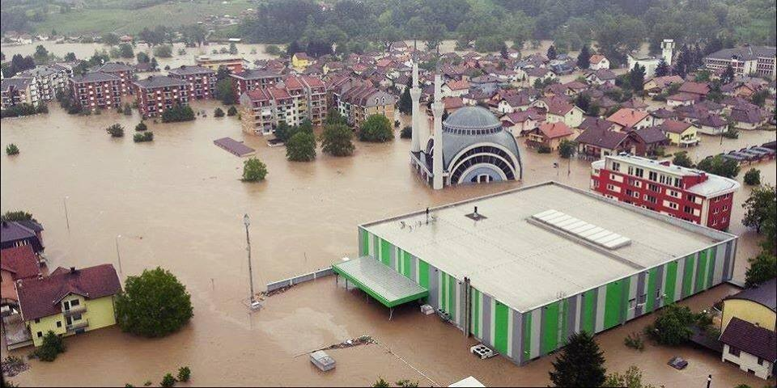
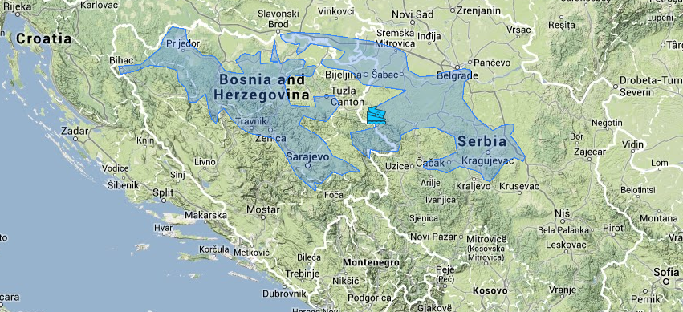
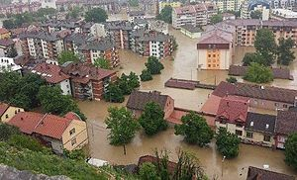
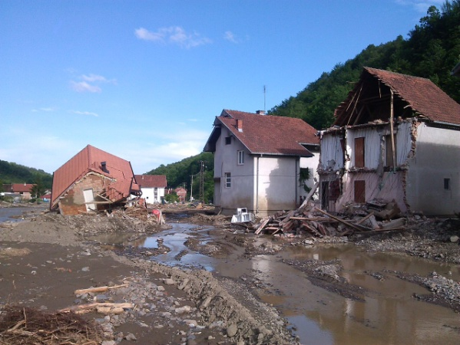
The idea/reason of the project
The floods that occurred in May 2014 in the Croatian territory, Bosnia and Herzegovina and Serbia have had disastrous consequences with great material damage and loss of human lives. In a drastic way, they once again reminded the country of the prevention of flash floods.
Notes:
Damage caused by these floods amounted to around 1.7 billion Euros only in Serbia. Considering all these facts, there is a need for a more detailed study of the problems of erosion and torrential floods and opportunities for the control of these processes.

Slide 5
The idea of the project
The proposal for the improvement of study programs in the Western Balkan area was given by the University of Sarajevo from Bosnia and Herzegovina.
The interest in the improvement of curricula with the subjects in the field of soil conservation and prevention of torrential floods was also expressed by the University of Banja Luka.
There are three universities in Serbia that have expressed the need for improvement of study programs by introducing new or modernized existing subjects.
Notes:
At these universities (Faculties of Forestry) protection against soil erosion and torrential floods is not studied enough and engineers don’t have the knowledge needed to solve these problems.
The University of Belgrade has accredited study programs of undergraduate and master studies in this field. However, the current study programs also require changes through modernization of the existing syllabuses and introduction of new subjects in accordance with the study programs of EU countries. At the universities in Novi Sad and Niš, within the existing study programs of water management (UNS) and environmental protection (UNI), there are only a few subjects related to this issue. Therefore, the need to improve existing and develop a new master program is also very strong.

Slide 6
The specific objectives
Wider Objective
Improvement and modernization of curricula for the education of experts for prevention of torrential floods in the Western Balkan
Improvement of land protection from soil erosion and prevention of torrential floods in WB;
Improvement of existing curricula and develop and implement new master curricula in the field of prevention from torrential floods, in compliance with the Bologna Declaration and EU good practices;
Implementation of the improved knowledge for practical solutions to prevention against torrential floods through project designing and execution
Increase education of local self-governments for soil erosion and torrential flood protection
Notes:
That could be achieved through the development of a master program established by five partner universities

Slide 7
SETOF Consorcium Partner country institutions
University of Belgrade (UB)
University of Novi Sad (UNS)
University of Niš (UNI)
University of Banja Luka (UBL)
University of Sarajevo (UNSA)
Institute of Forestry (INSZASUM)
Notes:
The problem of torrential floods was facing the countries of central Europe in the mid 19th century, when France and Austria adopted the first laws for the regulation of torrential catchments and forestry schools started to educate engineers in this field. Educational programs from France, especially from Austria were taken over by Balkan countries. There are many reasons for the existence of study programs in the field of soil and torrent control at forestry faculties. For this reason, the project included the Faculties of Forestry of the University of Banja Luka and the University of Sarajevo in Bosnia and Herzegovina. There is one Faculty of Forestry in Serbia at the University of Belgrade. This faculty has developed study programs in the field of erosion and torrent control. University of Novi Sad - Faculty of Agriculture has developed a study program of water regulation with subjects related to the field of erosion control and flood protection, and that is why the participation of this university in the project is expected. The Faculty of Occupational Safety of the University of Niš, with the study program environmental protection, has also expressed the need to improve its study program, especially in master studies. The partner institution is also Institute of Forestry from Belgrade, Serbia.

Slide 8
Programme country institutions
University of Natural Resources and Life Sciences (BOKU)
Ss. Cyril and Methodius University in Skopje (UNSCM)
University Mediterranea of Reggio Calabria (UNIRC)
Forest Research Institute at the Bulgarian Academy of Sciences (FRI-BAS)
Associated Partners institutions
Serbian Chamber of Engineers (SCE)
Forest Management Unit “Donjevrbasko” Banja Luka (FMU)
Cantonal Public Company “Sarajevo-forests” (CPCSF)
Notes:
The program country institutions are:
As you know the Aristotel Unversity of Thessaloniki was included in the consortium of the project, but unfortunatelly this university withdrew from our partnership 10 days before this meeting. According to the Guidelines for the Use of the Grant 2017, the Project coordinator - the Universityty of Belgrade is supposed to send to EACEA a request amendment explaining why is it necessary to replace the partner country institution and acording to that aslo a budget amendment. We have the consent of the University Mediterranea of Reggio Calabria to participate in the project.
We will officially receive the signed mandate and the rest that is necessary for the amendment.

Slide 9
Work packages
WP 1 - PREPARATION
Title: Analysis of soil erosion state and torrential floods in Western Balkan Countries
Leader: University of Belgrade, Ss. Cyril and Methodius University in Skopje
Duration: 15.11.2018 – 15.06.2019
Activities:
Analysis state of soil degradation/soil erosion in WBC
Analysis of torrential floods in WBC
Report of prevention measures for soil and torrent control in EU countries
Analysis and elaboration of bachelor and master curricula in field of soil and torrent control in EU countries
Workshop on bachelor and master curricula best practices in EU
WP2 – DEVELOPMENT
Title: Development of curricula
Leader: University of Novi Sad
Duration: 15.05.2019 – 15.05.2020
Activities:
Defined study requirements with Bologna standards
Defined goals, competences and learning outcomes of bachelor and master curricula
Established new and improved existing subjects of bachelor programme
Established new master programme
Study visits to EU partners university and analysis best practices
Harmonization of the proposed changes
Introduce and training teaching staff
Notes:
The project will be realized through activities which are divided into seven work packages. All work packages will be implemented through three main phases:
- Preparatory phase used for the analysis of the problems of erosion control and prevention of flash floods in the EU and Balkan countries as well as the existing curricula at universities in the program and partner countries;
- Development of a new master curriculum and improvement of the bachelor curriculum by modernization the existing and introducing new subjects, and
Implementation of improved curricula with professional trainings for final-year students, and trainings for local authority.
This slide shows the activities of WPs. Liders of each WPs will present activities in detail.
Under the title

Slide 10
Work packages
WP3 – DEVELOPMENT
Title: Implementation of developed curricula and training
Leader: University of Banja Luka
Duration: 15.11.2020 - 15-11-2021
Activities:
New bachelor subjects implemented
New master programme implemented
Evaluation of syllabi
Report of master and bachelor curricula quality
WP 4 -QUALITY PLAN
Title: Quality plan and monitoring
Leader: University Mediterranea of Reggio Calabria
Duration: 15.11.2018 – 15.11.2021
Activities:
Quality plan established
Quality control according to the adopted plan and measures for improving
External financial control
Quality assurance Committee meetings

Slide 11
Work packages
WP5 – DISSEMINATION & EXPLOITATION
Title: Dissemination of project results
Leader: University of Niš
Duration: 15.12.2018 – 15.11.2021
Activities:
Project website created and maintenance
- Establish dissemination plan
- Promotion material created
- Trainings plan defined and adopted
- Promotion trainings with engineers in enterprises
- Trainings in local communities
WP6 – DISSEMINATION & EXPLOITATION
Title: Exploitation of project results
Leader: University of Sarajevo
Duration: 15.02.2019 – 15.11.2021
Activities:
Sustainability plan created
Accreditation of master curricula
Promotion for students enrollment

Slide 12
Work packages
WP7 – MANAGEMENT
Title: Project management
Leader: University of Belgrade
Duration: 15.11.2018 – 15.11.2021
Activities:
Project management meetings
Steering committee meetings
Guidelines on the reporting and correspondence
Day–to-day coordination of project activities
Interim and finale report meeting

Slide 13
Expected impact of the project
Adopted new master curricula and improved existing curricula;
Increased teacher knowledge – improved and new curricula - higher level of knowledge of graduates – higher employment of graduates in practice;
The competitive universities at the regional and European level for the education of professionals in the field of erosion control and the prevention of torrential floods;
Harmonized methodologies for the prevention of torrential floods et regional level;
High level of knowledge of employees' engineers and local government for erosion end torrent control.
Notes:
Increased teacher knowledge will lead to - -and thus to–- as well as to the --

Slide 14
Short presentation of all partnering institutions
Work Packages presentation
Forming of management structures
Project website creating
Project finance and financial reporting
Guidelines on the reporting and correspondence
Project risk management
Action plan for the next six months
Discussion and closing the meeting
Notes:
In frst part of the meeting, the partners in the project will present their institutions. The project will be presented in more detail through presentations of work packages. On this meeting we will form a management structure, bodies. One of project activities is project web site creating. Tomorow will be present project finance and method of financial reporting. Tomorow, we will discus how we will perform corespodence, how we will manage project risks, we will talk about the action plan for next six months and we will discuss about the project realization.

