Slide 1
Soil Erosion and Torrential Flood Prevention: Curriculum Development at the Universities of Western Balkan Countries
Presentation of the SETOF project
Project coordinator
University of Belgrade
Notes:
dear colleagues, dear guests, it is my great pleasure to present the project
University of Belgrade Faculty of Forestry Team in cooperation with all project partners started preparing project proposal at the end of November 2016. Unfortunately, in the 2017 project proposal has been not selected for EU co-funding. But, we tried again and revised the first proposal according to the suggestions of the reviewers.

Slide 2
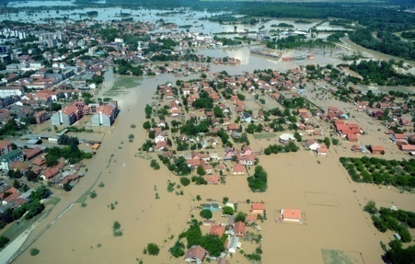
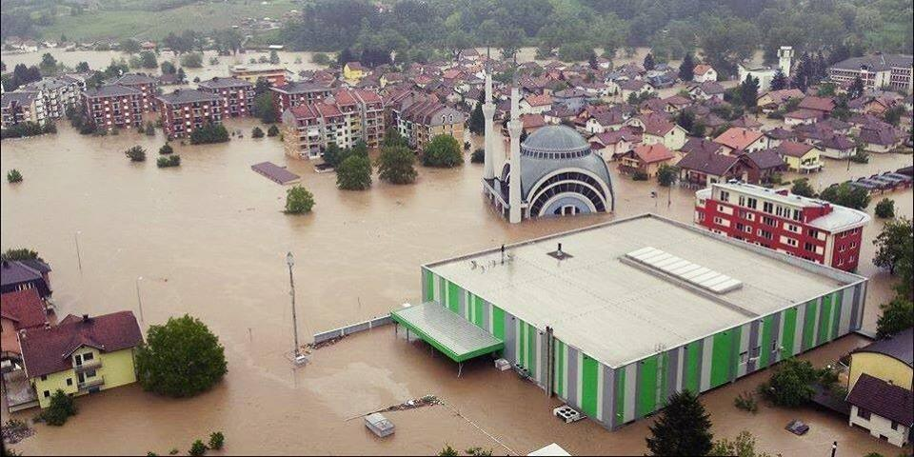
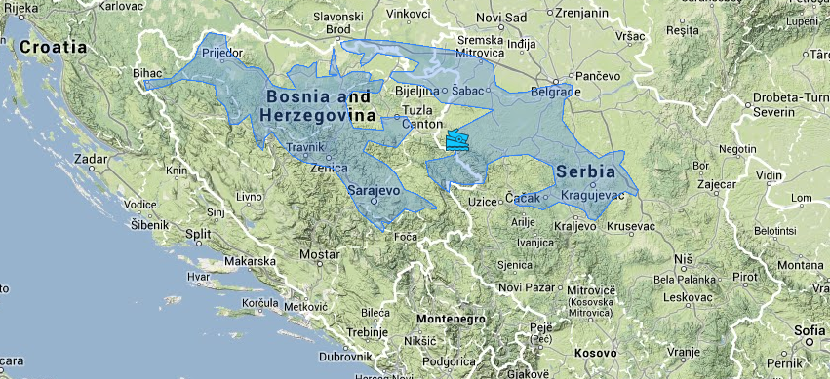
The idea/reason of the project
The floods that occurred in May 2014 in the Croatian territory, Bosnia and Herzegovina and Serbia have had disastrous consequences with great material damage and loss of human lives. In a drastic way, they once again reminded the country of the prevention of flash floods.
Improvement and modernization of curricula for the education of experts for prevention of torrential floods in the Western Balkan
The proposal for the improvement of study programs in the Western Balkan
There are three universities in Serbia that have expressed the need for improvement of study programs by introducing new or modernized existing subjects
Notes:
Damage caused by these floods amounted to around 1.7 billion Euros only in Serbia. Considering all these facts, there is a need for a more detailed study of the problems of erosion and torrential floods and opportunities for the control of these processes.

Slide 3
Project title: Soil Erosion and Torrential Flood Prevention: Curriculum Development at the Universities of Western Balkan Countries
Project acronym: SETOF
Reference Number: 598403-EPP-1-2018-1-RS-EPPKA2-CBHE-JP
Programme: Erasmus +
Key Action: Cooperation for innovation and the exchange of good practice
Action: Capacity Building in Higher Education
Action Type: Joint Projects
Call for Proposals: Call 2018 EAC/A05/2017
Duration of the project: 3 years
Start : 15.11.2018
Budget of the project: 865.070,00 EUR
Notes:
This slide shows basic project data, such as
Budget of the project that is estimated to be

Slide 4
SETOF Consorcium Partner country institutions
University of Belgrade (UB)
University of Novi Sad (UNS)
University of Niš (UNI)
University of Banja Luka (UBL)
University of Sarajevo (UNSA)
Institute of Forestry (INSZASUM)
Notes:
The problem of torrential floods was facing the countries of central Europe in the mid 19th century, when France and Austria adopted the first laws for the regulation of torrential catchments and forestry schools started to educate engineers in this field. Educational programs from France, especially from Austria were taken over by Balkan countries. There are many reasons for the existence of study programs in the field of soil and torrent control at forestry faculties. For this reason, the project included the Faculties of Forestry of the University of Banja Luka and the University of Sarajevo in Bosnia and Herzegovina. There is one Faculty of Forestry in Serbia at the University of Belgrade. This faculty has developed study programs in the field of erosion and torrent control. University of Novi Sad - Faculty of Agriculture has developed a study program of water regulation with subjects related to the field of erosion control and flood protection, and that is why the participation of this university in the project is expected. The Faculty of Occupational Safety of the University of Niš, with the study program environmental protection, has also expressed the need to improve its study program, especially in master studies. The partner institution is also Institute of Forestry from Belgrade, Serbia.

Slide 5
Programme country institutions
University of Natural Resources and Life Sciences (BOKU)
Ss. Cyril and Methodius University in Skopje (UNSCM)
University Mediterranea of Reggio Calabria (UNIRC)
Forest Research Institute at the Bulgarian Academy of Sciences (FRI-BAS)
Associated Partners institutions
Serbian Chamber of Engineers (SCE)
Forest Management Unit “Donjevrbasko” Banja Luka (FMU)
Cantonal Public Company “Sarajevo-forests” (CPCSF)
Notes:
The program country institutions are:
As you know the Aristotel Unversity of Thessaloniki was included in the consortium of the project, but unfortunatelly this university withdrew from our partnership 10 days before this meeting. According to the Guidelines for the Use of the Grant 2017, the Project coordinator - the Universityty of Belgrade is supposed to send to EACEA a request amendment explaining why is it necessary to replace the partner country institution and acording to that aslo a budget amendment. We have the consent of the University Mediterranea of Reggio Calabria to participate in the project.
We will officially receive the signed mandate and the rest that is necessary for the amendment.

Slide 6
Expected impact of the project
Adopted new master curricula and improved existing curricula;
Increased teacher knowledge – improved and new curricula - higher level of knowledge of graduates – higher employment of graduates in practice;
The competitive universities at the regional and European level for the education of professionals in the field of erosion control and the prevention of torrential floods;
Harmonized methodologies for the prevention of torrential floods et regional level;
High level of knowledge of employees' engineers and local government for erosion end torrent control.
Notes:
Increased teacher knowledge will lead to - -and thus to–- as well as to the --

Slide 7
Challenges encountered
Change of consortium
Puraches of equipement
Different national legislations
....

