Slide 1
Short report of the Project Coordinator
Prof. Nada Dragović

Slide 2
After realization of PMU and SC meeting in May 2019, we started to prepare documentation for the 1st installment request.
Agreement on the request for amendment due to the changes in partnership we received from EACEA on 16.06.2019 and then we started to transfer 1st instalment of first pre-financing to the beneficiary.
We received signed First instalment requests from all partners on the project at the beginning of July, while the funds are transferred by the end of July (except for the Ss. Cyril and Methodius University in Skopje).
Notes:
I will present to you briefly the most important events in the past 6 months connected our project.
We get the First instalment request from University of Skoplje then days ago. The process of transferring funds is ongoing.

Slide 3
At the end of June and beginning of July 2019, we submitted requests for the launching a public procurement procedure for website development, procurement of equipment and promotional material.
Public procurement for the design and development of the website was opened in July, and the contract was concluded at the end of July. Since the beginning of September, the SETOF project website www.setof.org is up and running. The process of the other two public procurements was interrupted in August due to holiday.

Slide 4
The process continued in September, but the joint procurement of equipment for universities in Serbia has not yet begun. There were problems with changing the equipment specification.
In addition, there was a problem in launching a joint public procurement for equipment for universities in Bosnia and Herzegovina. According to the law of B&H for public procurement, the necessary funds have to be in the university account. As this is not defined on that way in the PA, it is neccessary to signed annexes to the agreement between UB and UBL and UNSA. The procedure is ongoing.
Due to the insufficient promptness of the UB Rectorate, the public procurement procedure for promotional material has not yet been initiated.
Notes:
hope it doesn't last long

Slide 5
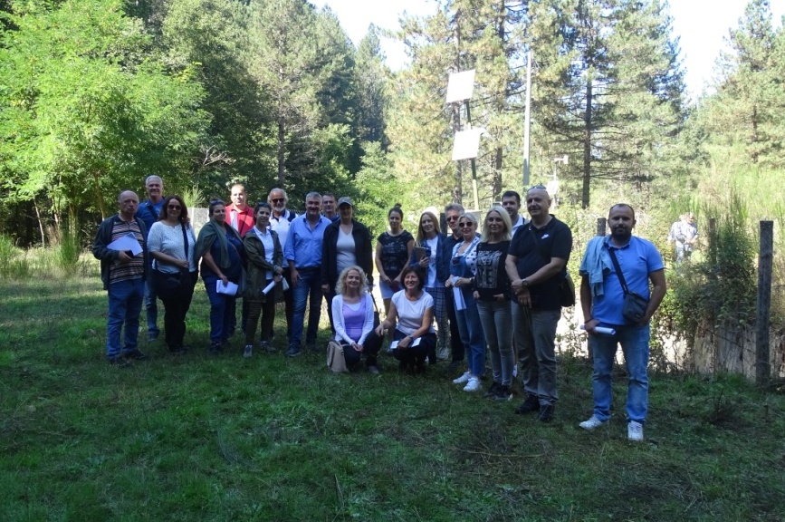
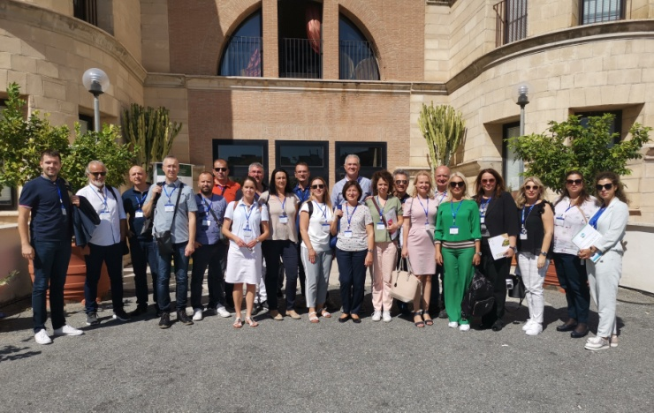
In the period from September 30 to Octobar 1 Workshop on Bachelor and master curricula was organized in EU at University Mediterranea in Reggio Calabria, Italy.
Due to obtaining approval for partnership replacement in June, the Quality Assurance Committee meeting could not be held in May when PMU and SC meetings were held.
1st Quality assurance Committee meeting was hold on October 2 2019 at University Mediterranea in Reggio Calabria who is a leader WP4 Quality plan.

Slide 6
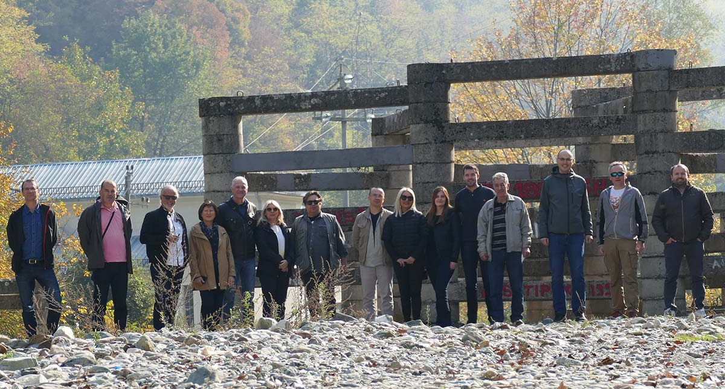
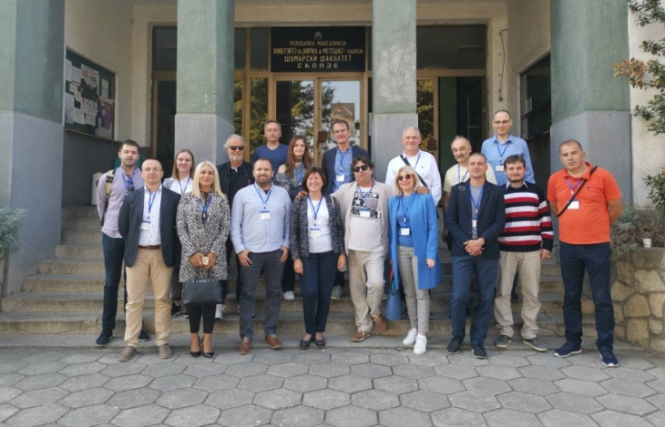
Workshop on bachelor and master curricula was organized on October 28 to 29 2019 at the University Ss. Cyril and Methodius in Skopje. At the workshop professors from Faculty of Forestry UNSCM presented their curricula and syllabuses in field of soil erosion and prevention of torrential floods as well as examples of erosion and torrential floods control in practice.

Slide 7
Representatives of the coordinator and partner country in the project consortium participated in the Regional Cluster Meeting on CBHE projects' Impact in the Western Balkans in Durres (Albania) on the 22nd and 23rd of October.
A Claster meeting of CBHE curriculum development projects involving partners from Bosnia and Herzegovina will be held at University in Banja Luka, where the representatives of SETOF project will participate.

Slide 8
The planned and realized activities

Slide 9
WP 1 PREPARATION Analysis of soil erosion state and torrential floods in Western Balkan Countries
 | Activities | Time | Done
1.5 | Workshop on bachelor and master curricula in EU
 | Agenda, Attendance list and Minutes of meeting – UB in consultation with other partner institutions | mid-September, 2019 | Done Sep. 30 – Oct. 1 October 28-29
Notes:
WP1 has 5 activities, 4 activities finished by June 2019 and one activity in past six months. Activity Workshop on bachelor and master curricula in EU was planed on the meeting at the University Mediterranea in Regio Calabria in September. The workshop was from September 30 to Ocrober 2nd in Reggio Calabria and was organized very well. All deleve this event you can see on website. Another workshop on bachelor and master curricula best practices was organized at University Sv. Ciril and Methodius in Skopje, Faculty of Forestry – in October 28-29 October 2019.

Slide 10
WP 2 – DEVELOPMENT Development of curricula |  | Time | Done
2.1 | Defined study requirements with Bologna standards
 | Report on compliance requirements with Bologna standars - UNS in cooperation with other partner institutions | 15.07.2019 | done
2.2 | Defined goals, competences and learning outcomes
 | Report on defined goals, competence and learning outcomes - UNS in cooperation with other partner institutions | 15.09.2019 | done
2.3 | Established new and improved existing subjects on bachelor
 | Report of established new and improved existing subjects on bachelor - UNS in cooperation with other partner institutions | 15.07.2019-15.02.2020 | In progress
2.4 | Established new master programme
 | Report of establiched new master programme | 15.07.2019-15.05.2020 | In progress
Notes:
Activities WP2 started in July 2019. This WP has 7 activities. Two activities 2.1. Defined study requirements with Bologna standards and 2.2 Defined goals, competences and learning outcomes were completed before this meeting and both delayed. Activities Established new and improved existing subjects on bachelor and 2.4 Established new master programme start this year and end next.

Slide 11
WP 2 – DEVELOPMENT Development of curricula |  | Time | Done
2.5 | Study visits EU university and analysis best practices
 | Report of the study visit | 15.05.2019 – 15.11.2019 | Done May 2019
2.6 | Harmonization of the proposed changes
 | Report of the harmonization of the proposed changes | 15.07.2019 – 15.05.2020 | In progress
Notes:
Frst Study visit EU university was held in Austria in May 2019 and other 3 Study visits EU universities will be organize next year. Activity 2.6. Harmonization of the proposed changes hes duration from this year to May 2020

Slide 12
 | WP4 QUALITY PLAN Quality plan and monitoring | Time | Done
4.1 | Quality plan established
 | Report of quality plan establiched – UNIRC in consultation with other participating institutions UB, UNSCM, FRI-BAS | 15.02.2019 | done
4.4 | Quality assurance Committee meeting
 | Minutes of the Quallity assurence Committee meeting- UNIRC in consultation with other participating institutions UB, UNSCM, FRI-BAS | 15.05.2019 | done
Notes:
The project get approval for partner replacements in mid June 2019. After the official involvement in the consortium leader of WP4 - UNIRC can take the responsibilities. Frst version of Quality plan was proposed by end July. Project participants were able to make suggestions for a proposed version. The Quality plan Version I was adopted at the Quality assurence committee meeting. 1st Quality assurence committee meeting was held at University Mediterranea in Reggio Calabria on October 2 2019.

Slide 13
 | WP5 - DISSEMINATION & EXPLOITATION Dissemination of project results | Time | Done
5.1 | Project website created and maintenance
 | Project website created - UB in consultation with UNI | 15.02.2019 | done
5.2 | Establish a dissemination plan
 | Report of established a dissemination plan - UNI in consultation with other partner institutions | 15.05.2019 | done
5.3 | Promotion material created
 | Report of created promotion material - UNI in cooperation with UB | 15.05.2019 | not done
Notes:
Website od SETOF project was created finally by end August. Website will be maintanance all the time for the whole duration of the project. Dissemination plan was adopted at the Steering committee meeting in Innsbruck on May 17 2019. A request for the launch of a public procurement procedure for promotional material has been submitted to the Rektorate of University of Belgrade, but the procedure has not yet been initiated

Slide 14
 | WP7 – MANAGEMENT Project management | Time | Done
7.1 | Project management meeting
 | Minutes of the meeting - UB in consultation with other partner institutions | 15.11.2019 | done
7.2 | Steering committee meeting
 | Minutes of the meeting - UB in consultation with other partner institutions | 15.11.2019 | done
7.4 | Day–to-day coordination of project activities
 | Report of day-to-day coordination - UB in consultation with other partner institutions | 15.11.2019 | done
Notes:
Project management Unit meeting was held yesterday on November 18th and Steering committee meeting is today. My collegue Tijana Vulević will present Reporting and correspodence on the project and day-to.day coordination. Next PMU, SC and QAC meetins are planing in Sarajevo on mid May.

