Slide 1
FINANCIAL STATEMENT
18-19 November 2019, Banja Luka

Slide 2
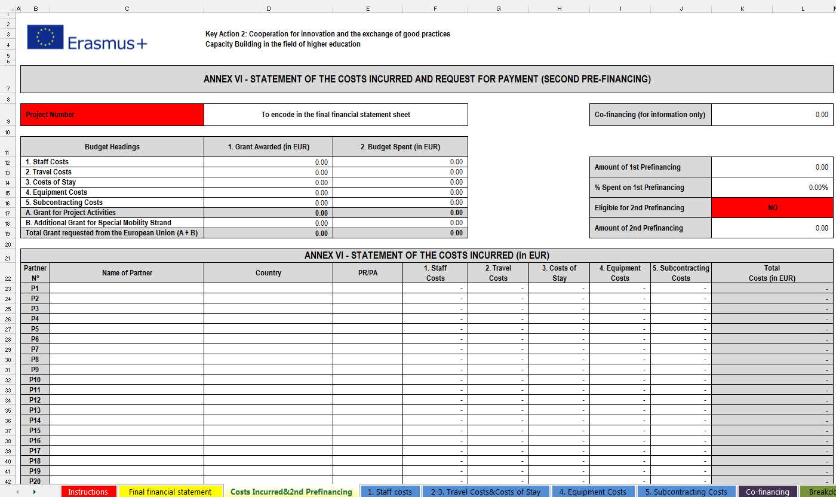
Financial reporting
Instructions
Final financial statement
Costs incurred&2nd Prefinancing
1. Staff costs
2-3. Travel Costs&Costs of Stay
4. Equipment Costs
5. Subcontracting Costs
Co-financing
Breakdown and Project Funding
Breakdown Staff and Travel Costs

Slide 3
PROOF OF PAYMENT
for travel costs (travel tickets, boarding passes... )
- for stay cost

Slide 4
R E M I N D E R !
University of Belgrade- Cord SETOF
100% of SETOF grant
equipment
1st instalment of first pre-financing
50%
first pre-payment
50%
rest of the money
2nd instalment of first pre-financing
50%

Slide 5
The present situation!
Institution | 1st instalment of first pre-financing SPENT
UB | 88.7%
UNS | no information
UNI | 39.3%
UBL | 14.2%
USA | 19%
INSZASUM | 80.1%
BOKU | no information
UNSCM | no information
UNIRC | 54.2%
FRI-BAS | 72.2%
In order to request
the 2nd instalment of first pre-financing
we need to spend over 90% of
the 1st instalment of first pre-financing
with evidence/proof.

Slide 6
R E M I N D E R !
pre-financing payment of 50% of the maximum amount upon entry into force of the Agreement
second payment of 40% of the maximum amount if:
at least 70% of the previous pre-financing installment is spent
the statement of costs incurred and the request for payment is sent to EACEA
the progress report on the implementation of the Action (Intermediate report) is sent to EACEA
balance of 10% upon the approval of the Final Report

Slide 7
Financial statement- Cord- UNB
+EQ
72.2%

Slide 8
Financial statement- P1- UNS
NO FINANCIAL STATEMENT

Slide 9
Financial statement- P2- UNI
+EQ
42.5%

Slide 10
Financial statement- P3- UBL
+EQ
46.7%

Slide 11
Financial statement- P4- UNSA
+EQ
49.3%

Slide 12
Financial statement- P5- INSZASUM

Slide 13
Financial statement- P6- BOKU
NO FINANCIAL STATEMENT

Slide 14
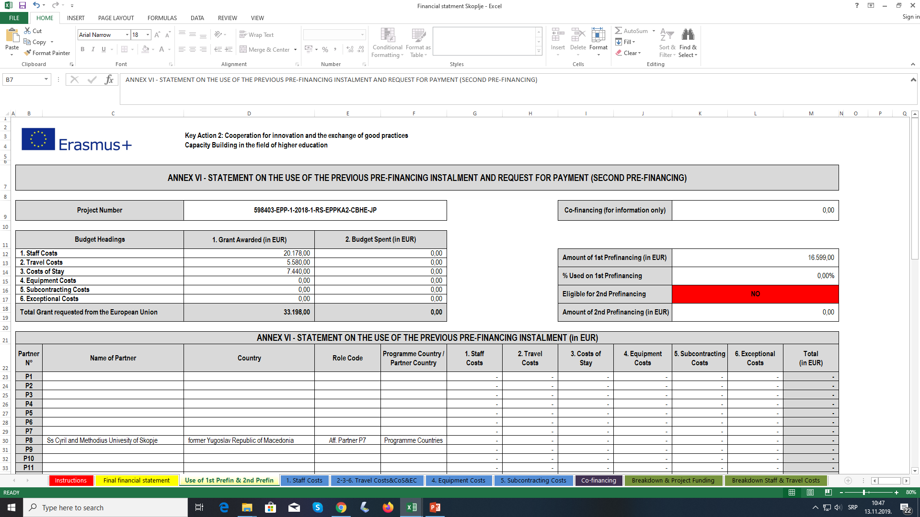
Financial statement- P7- UNSCM
NO FINANCIAL STATEMENT

Slide 15
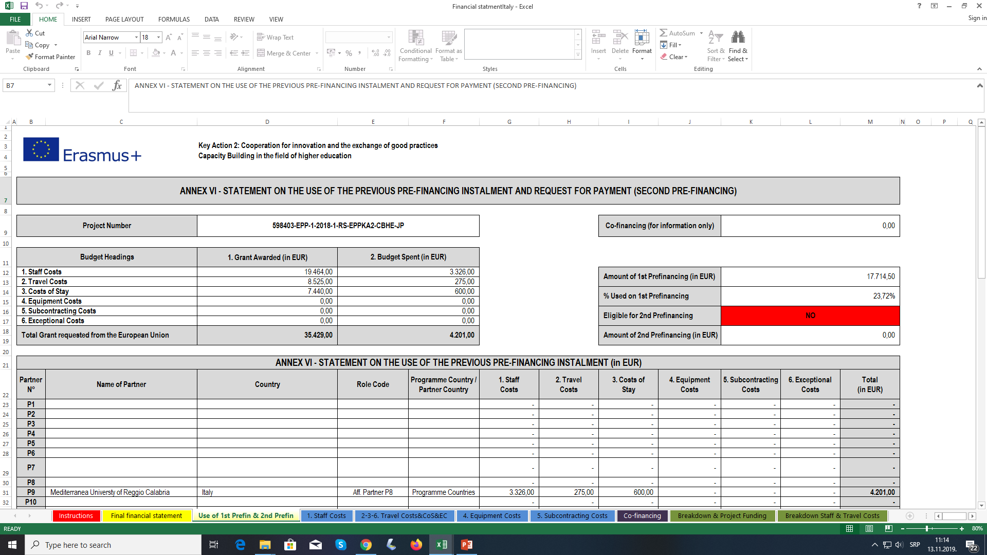
Financial statement- P8- UNIRC

Slide 16
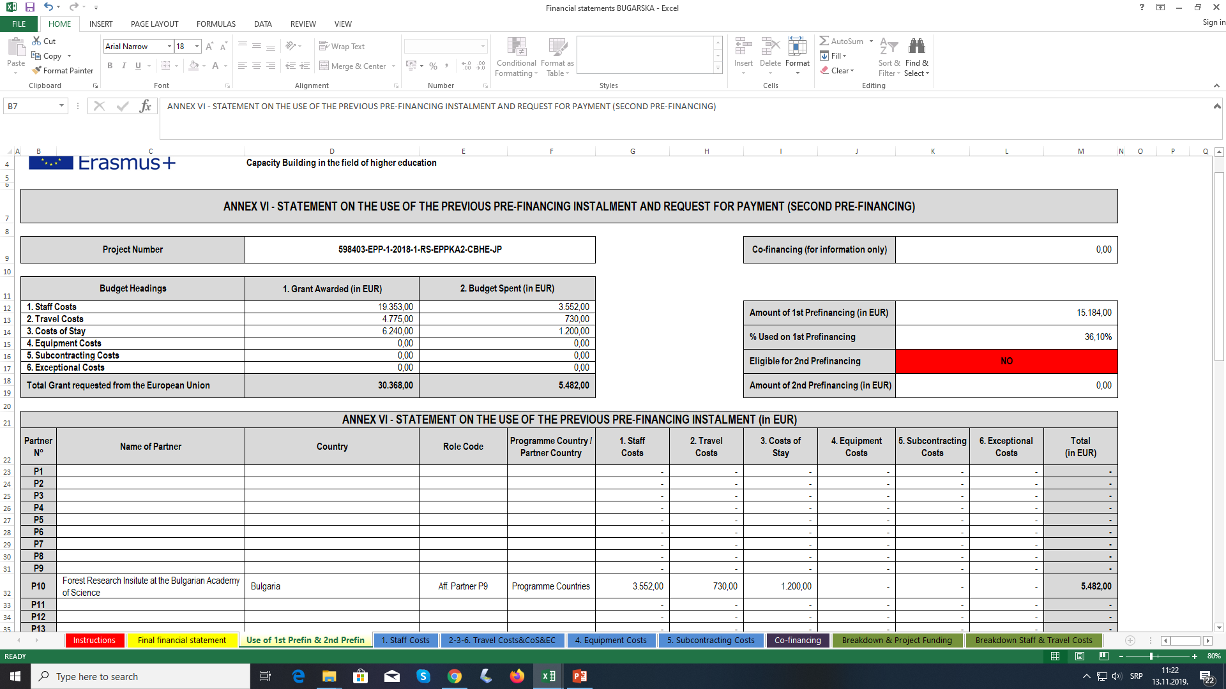
Financial statement- P9- FRI-BAS

Slide 17
Financial statement - SETOF
+57.97% we must spent
(-46.2%EQ) = about 11%
70% SETOF

Slide 18
NECESSARY! - spent more than 70% of the funds by March (out of 50% recived) to make request for the next tranches of 40% of the project

