Slide 1
Presentation of existing subject syllabuses in the field of soil erosion and torrential flood prevention
Proposal for new and improved subjects on existing bachelor and master programmes at the Faculty of Forestry UB
Ratko Ristić

Slide 2
STUDY PROGRAMME
OF ECOLOGICAL ENGINEERING IN SOIL AND WATER RESOURCES PROTECTION
3. level
DOCTORAL
STUDY
(PhD) 180 ECTS
480 ECTS
doctor of biotechnical sciences
2. level
MASTER STADY PROGRAMME (MSc) 60 ECTS
300 ECTS
master engineer
level
UNDERGRADUATE STUDY PROGRAMME (BSc) 240 ECTS
240 ECTS
graduate engineer

Slide 3
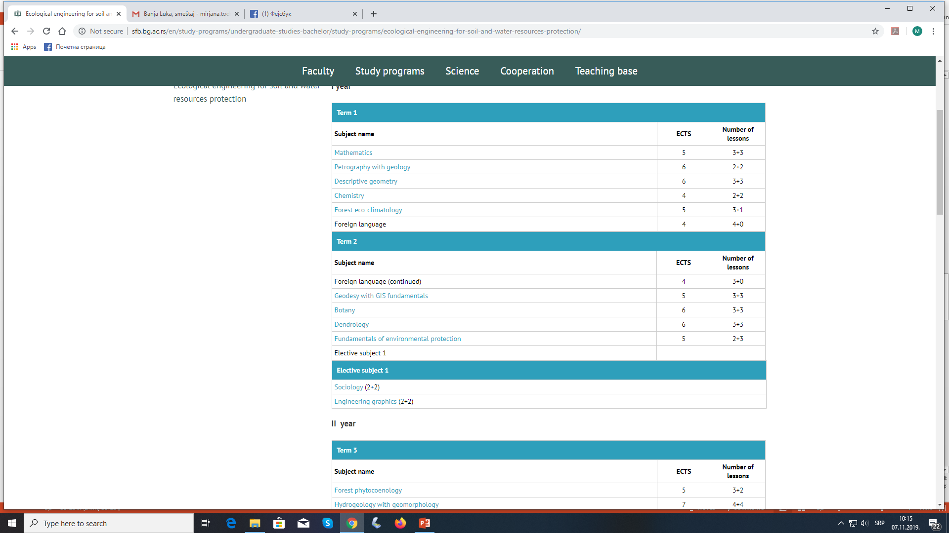
Ecological engineering for soil and water resources protection
Undergraduate study programme
I year

Slide 4
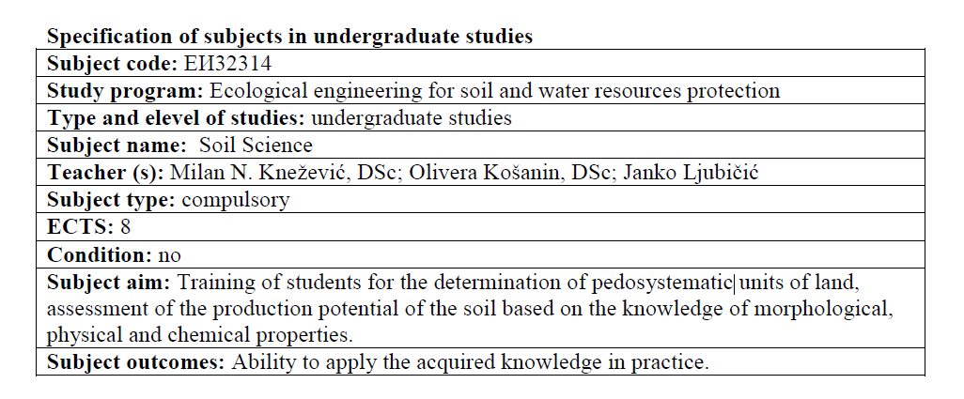
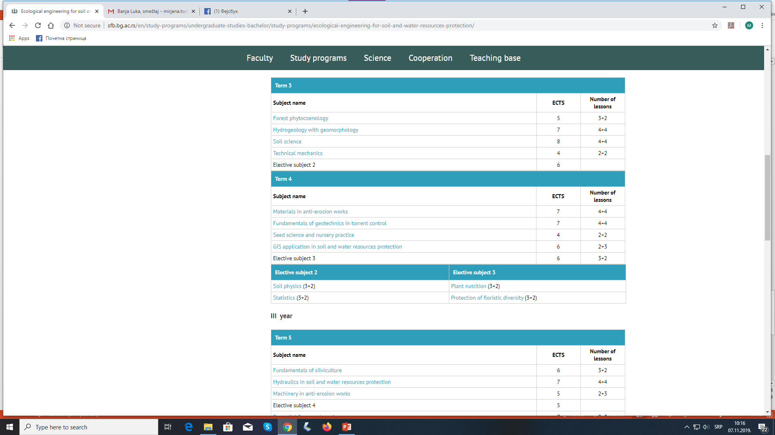
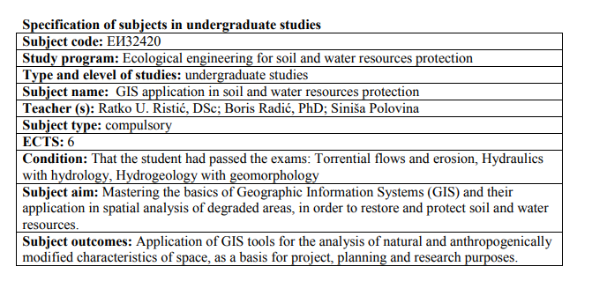
II year

Slide 5
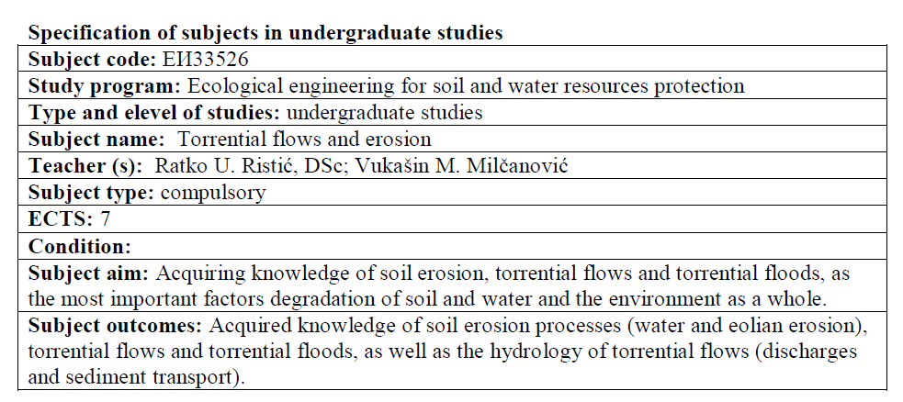
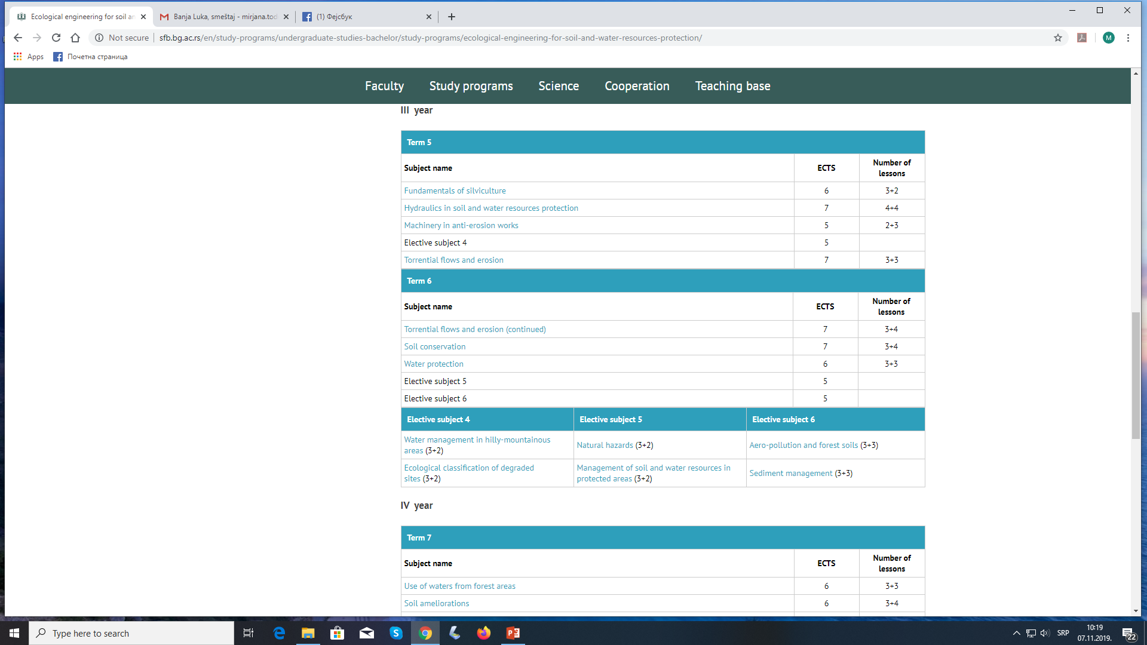
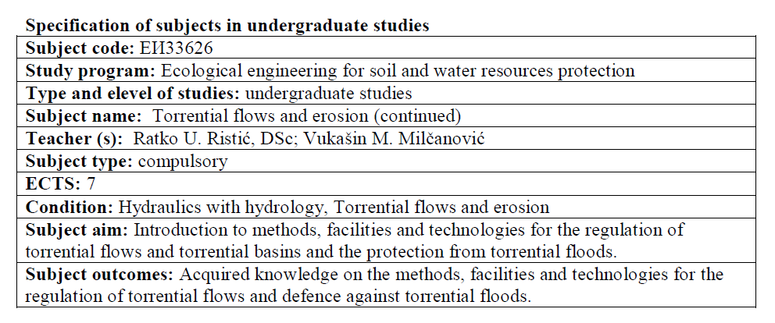
III year

Slide 6
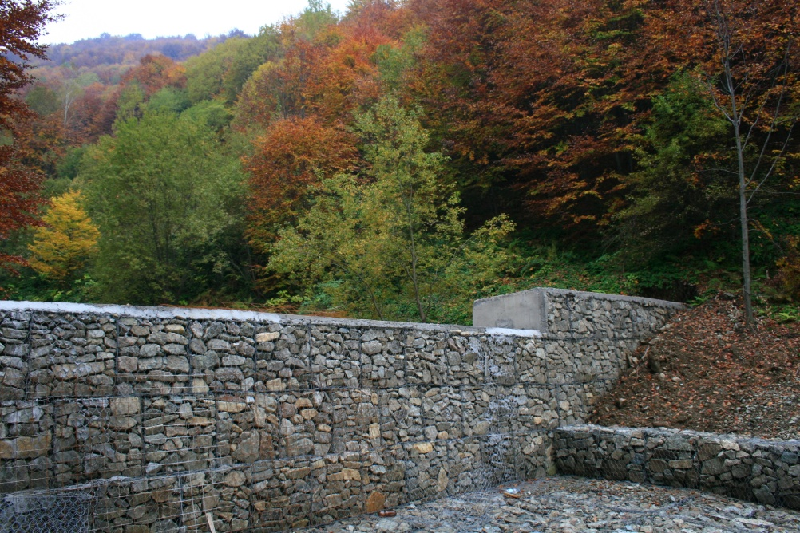
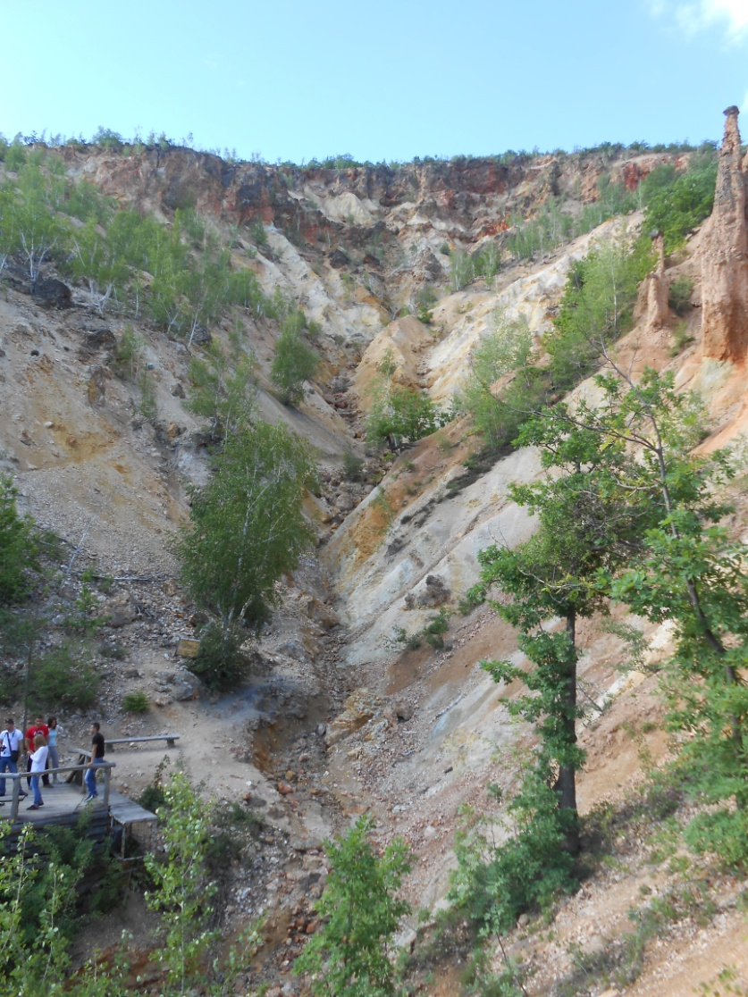
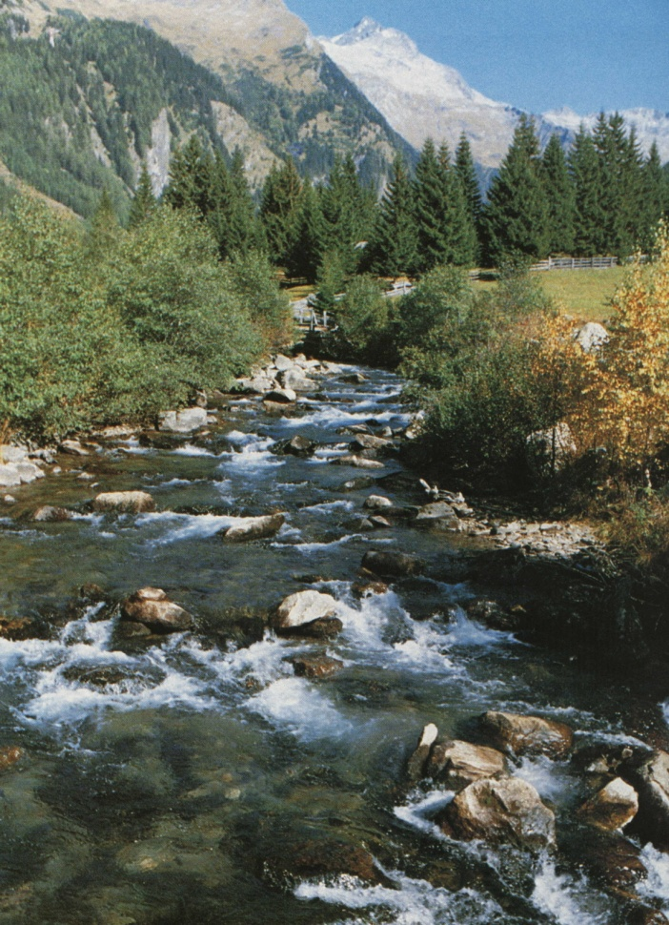
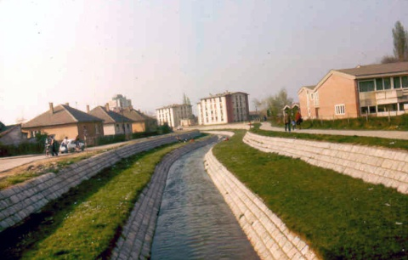

Slide 7
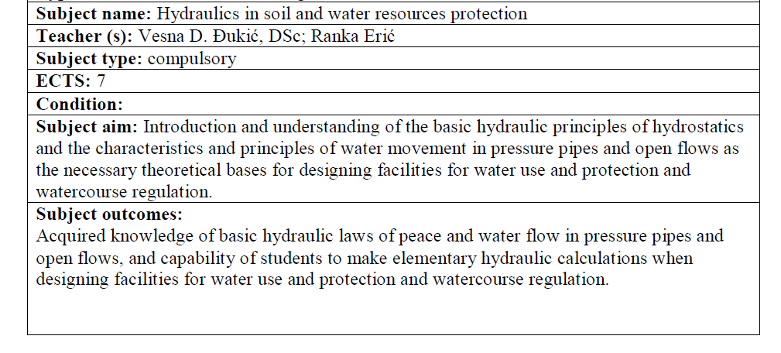
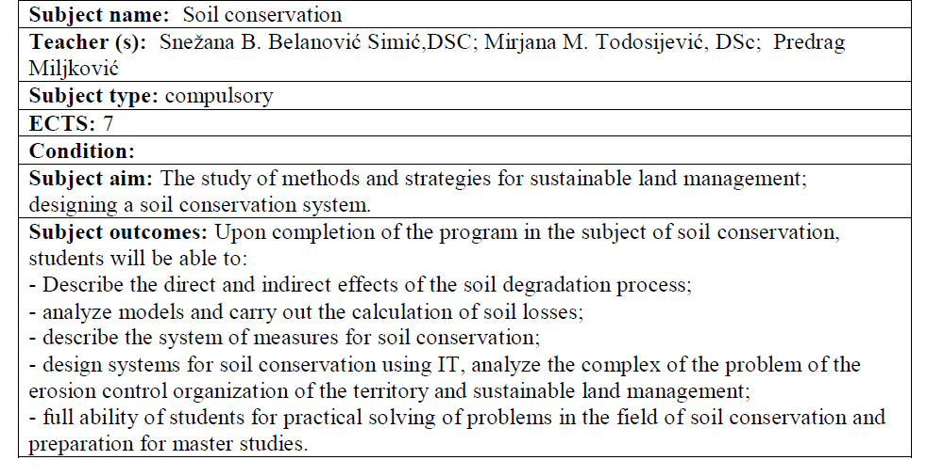
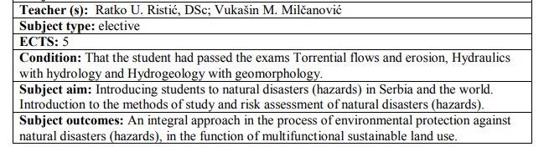
III year

Slide 8
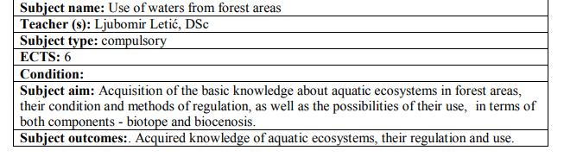
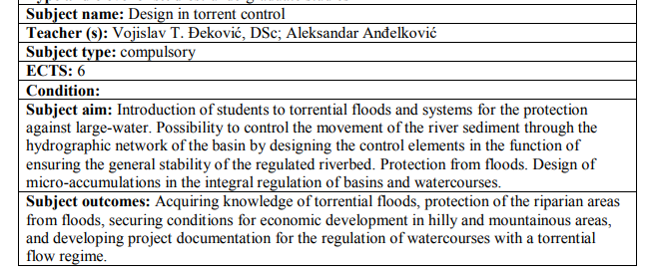
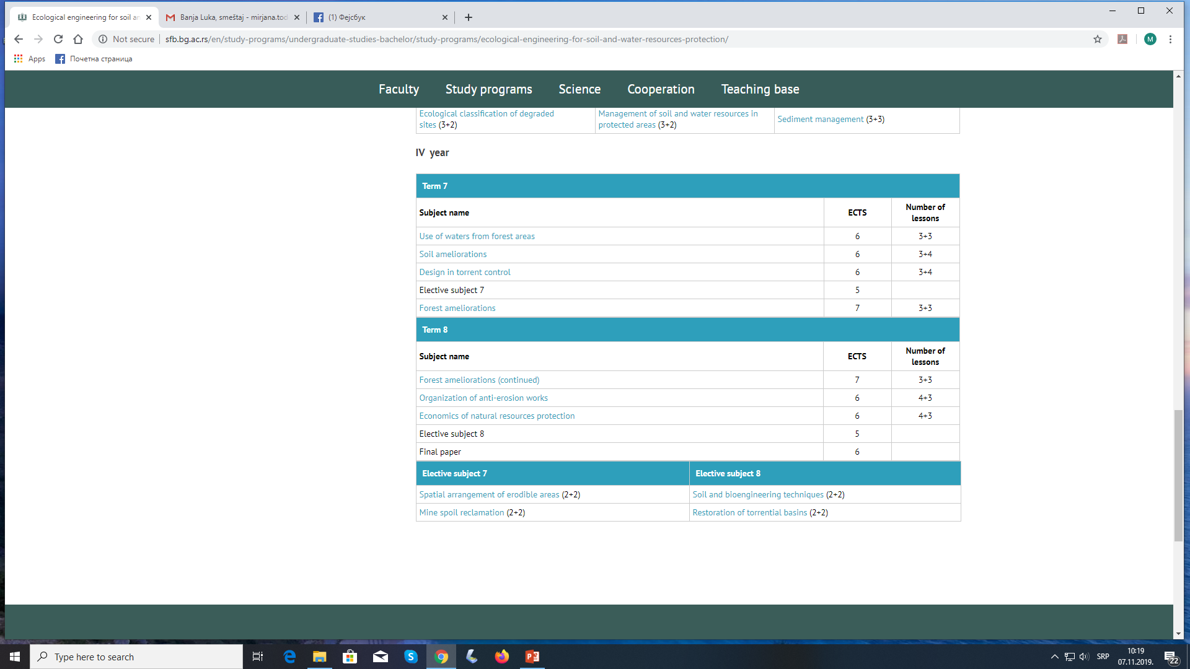
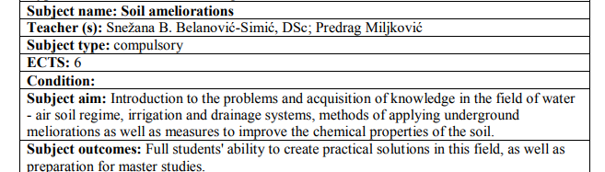
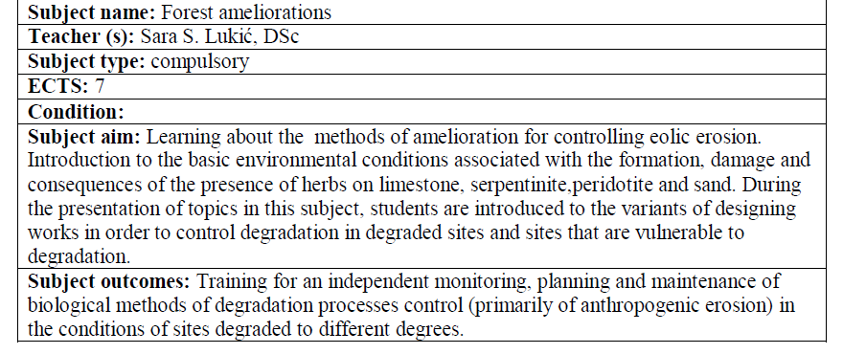
IV year

Slide 9
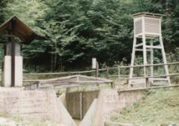
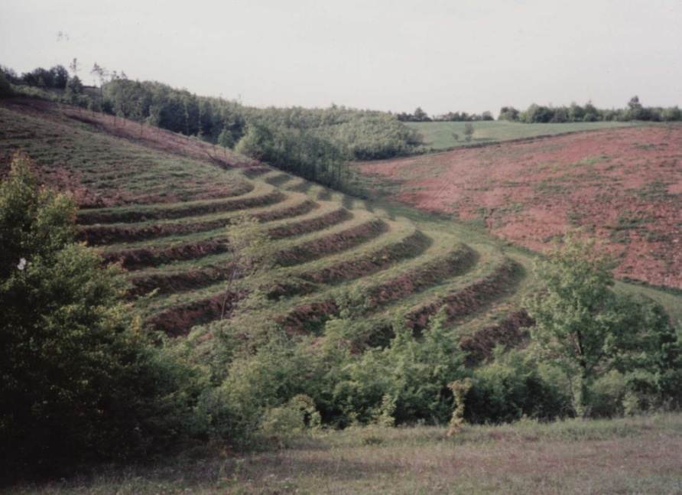
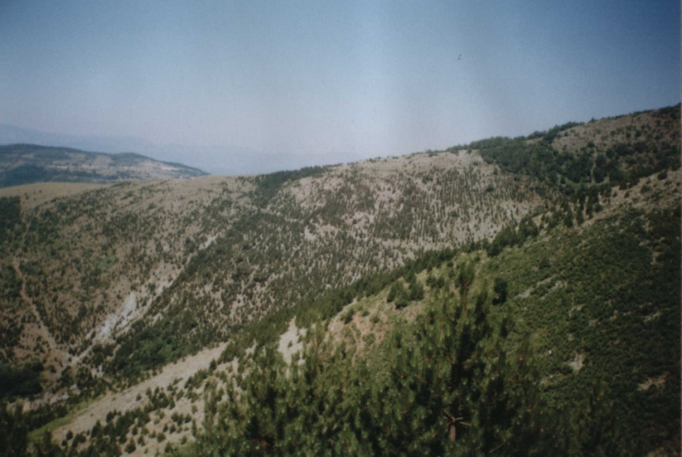
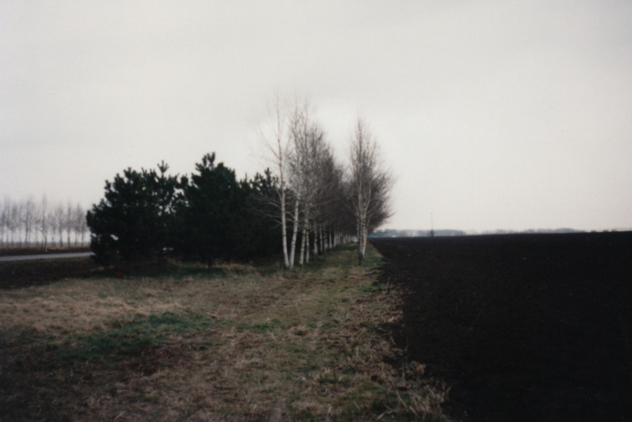
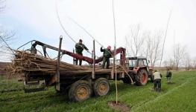

Slide 10
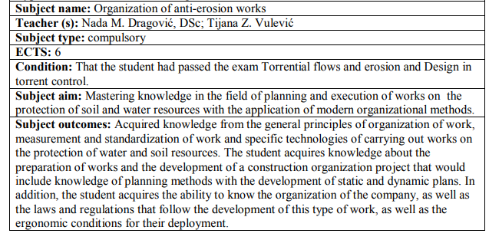
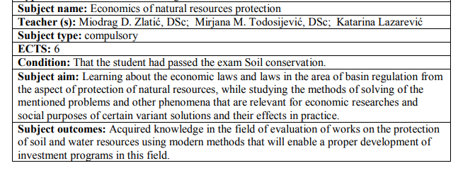

Slide 11
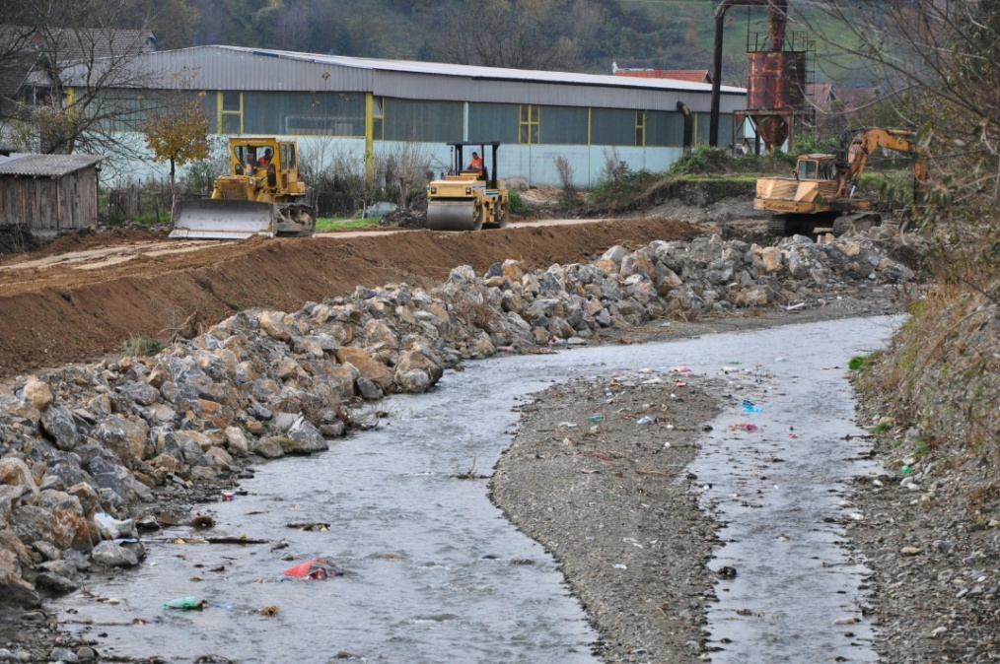
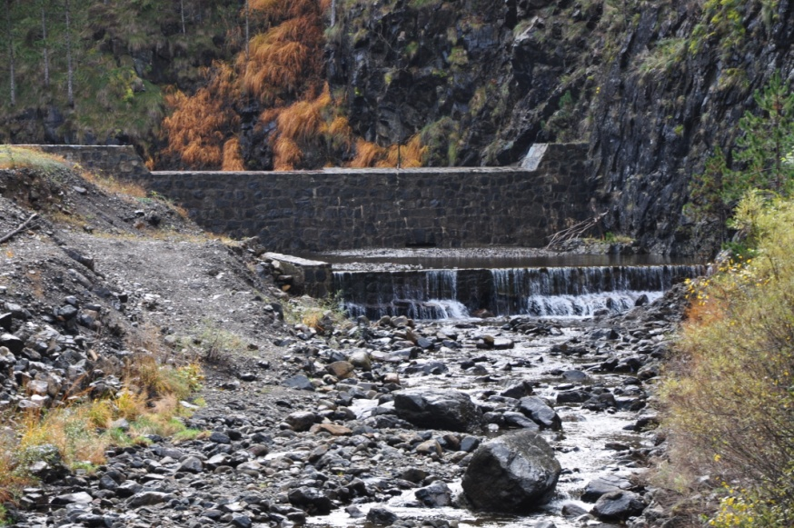
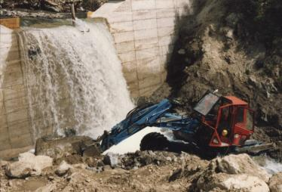

Slide 12

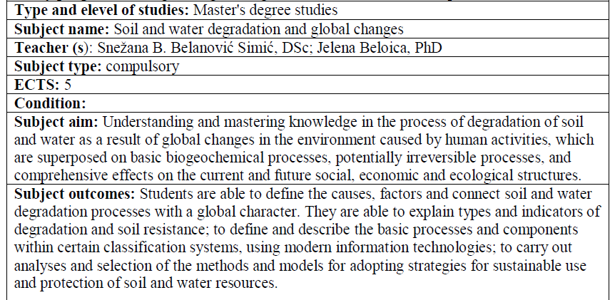
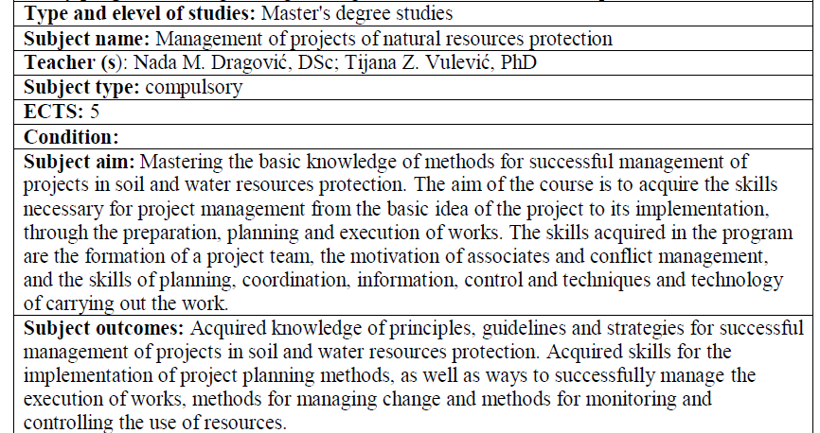
M1 – Protection of water resources in hilly-mountainous areas

Slide 13
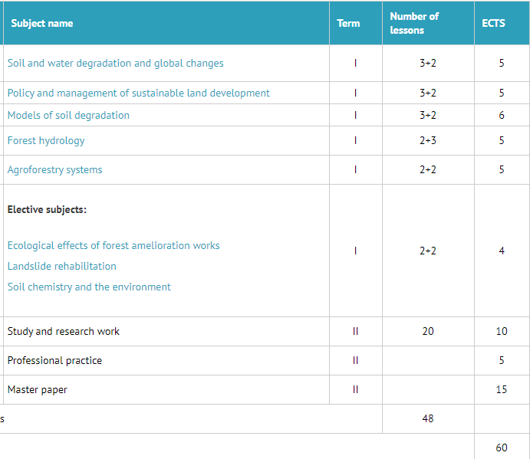
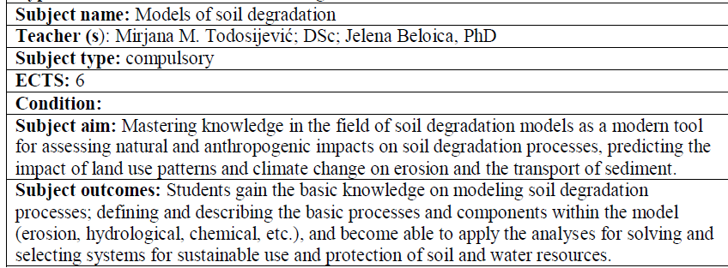
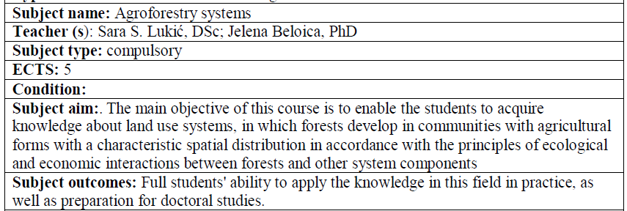
M2 – Degradation and protection of soil resources

Slide 14
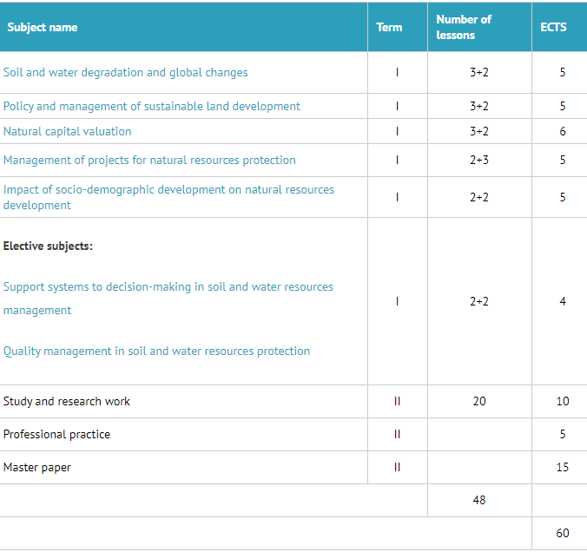
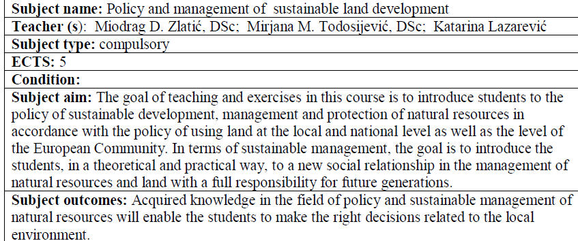
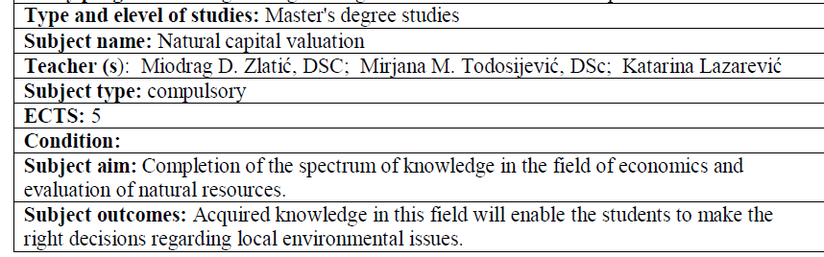
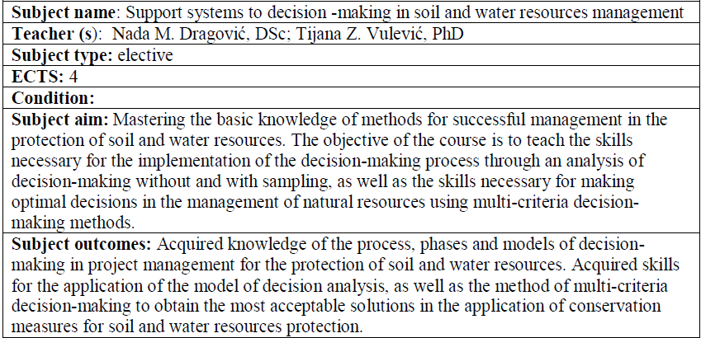
M3 – Management of sustainable development in degraded areas

Slide 15
Title | Ecological engineering for soil and water resources protection
Level of study | Bachelor study programme
List of subjects and credits (ECTS or comparable credit system) for each of them | List of a new subjects: 1. Revitalization of small water courses | 5 ECTS
 | 2. Managing risks from natural disasters and climate change | 5 ECTS
 | 3. Fundamentals of forest hydrology | 5 ECTS
 | 4. Hydraulics of open channels | 5 ECTS
 | 5. Economics of soil and water resources protections | 6 ECTS

Slide 16
Title | Ecological engineering for soil and water resources protection
Level of study | Bachelor study programme
List of subjects and credits (ECTS or comparable credit system) for each of them | List of modernised subjects: 1. Land conservation | 7 ECTS
 | 2. Sediment management | 5 ECTS
 | 3. Organization of anti-erosion works | 6 ECTS
 | 4. Management of soil and water resources in protected areas | 5 ECTS

Slide 17
Title | Ecological engineering for soil and water resources protection
Level of study | Master study programme
List ofsubjects and credits (ECTS or comparable credit system) for each of them | List of a new subjects: Surface water resources Morphological changes of regulated riverbed and aquatic ecosystems Stabilization of the terrain | 6 ECTS 4 ECTS 4 ECTS

Slide 18
Title | Ecological engineering for soil and water resources protection
Level of study | Master study programme
List ofsubjects and credits (ECTS or comparable credit system) for each of them | List of a modernised subjects: Water resources in hilly-mountainous Quality management in soil and water resources protection Natural capital valuation | 6 ECTS 4 ECTS 6 ECTS

