Slide 1
Overview of existing bachelor and master programme at the Faculty of Forestry UBL
Partner institution: UNIVERSITY OF BANJA LUKA Faculty of Forestry
Dr Jugoslav Brujic
November, 18-19, 2019. Banja Luka

Slide 2
FACULTY OF FORESTRY
Eight departments:
Department of Silviecology
Department of forest genetics and forest establishment
Department of integral protection of forest ecosystems
Department of forest resources usage
Department of economics and organization
Department of silviculture
Department of forest management
Department of hunting

Slide 3
Department of Silviecology is leading in activities directed towards:
Land resources,
Soil erosion and conservation
Biodiversity
Dendrology
Phytocoenology
Forests and Climate change etc.

Slide 4
STUDY PROGRAMMES

Slide 5
STUDY PROGRAMME | CYCLE | ECTS | DEGREE OBTAINED | OBLIGATORY SUBJECTS | ELECTIVE SUBJECTS
Forestry | I | 240 | Bachelor of Forestry | 39 | 27
Wood processing | I | 240 | Bachelor of Forestry | 32 | 16
Forestry | II | 60 | Master of Forestry | 10 | 13
Forestry | II | 120 | Master of Forestry 1. Silviculture and forest protection 2. Forest utilization 3. Forest management planning | 13 | 18
Management of forest resources on natural basis | II | 120 | Master of Forestry | 13 | 12

Slide 6
STUDY PROGRAMME | CYCLE | ECTS | DEGREE OBTAINED | OBLIGATORY SUBJECTS | ELECTIVE SUBJECTS
Forestry | III | 300 | PhD of Forestry

Slide 7
BACHELOR STUDY PROGRAMME
MODULE: Forestry 4+1
I cycle studies: | Obligatory subjects Dendrology Soil science Phytocoenology Forest and environment Forest ecoclimatology Forest soils Elective subjects Forest biodiversity Land degradation Forest ecology Nature protection

Slide 8
DEPARTMENT OF SILVIECOLOGY
Land resources,
Soil erosion and conservation
Biodiversity
Dendrology
Phytocoenology
Forests and Climate change etc.

Slide 9
ID card
Department of Silviecology
MODULE: Forestry 4+1
I cycle studies: | Obligatory subjects Dendrology Soil science Phytocoenology Forest and environment Forest ecolimatology Forest soils Elective subjects Forest biodiversity Land degradation Forest ecology Nature protection

Slide 10
ID card
Department of Silviecology
MODULE: Silviecology and Forest formation 4+1
II cycle studies: 60 ECTS | Obligatory subjects Syndinamic of forest phytocoenoses Management of Forest genetic resources Forest soils-clasiffication and usage Elective subjects Mapping of forest vegetation Forest and climate change Forest plantations Environmental forest functions

Slide 11
ID card
Department of Silviecology
MODULE: Forest management on sustainable basis 3+2
II cycle studies: 120 ECTS | Obligatory subjects Sindynamic of forest phytocenosis Management of Forest genetic resources Forest soils-clasiffication and usage Elective subjects Mapping of forest vegetation Forest and climate change Forest plantations Environmental forest functions

Slide 12
DEPARTMENT USE OF FOREST RESOURCES
Forest use I
Forest use II
Forest utilization technologies
Forest communications etc.

Slide 13
ID card
Department: Use of Forest Resources
MODULE: Forestry 4+1
I cycle studies: | Obligatory subjects Anatomy and properties of wood Forest utilization I Forest utilization II Forest communication Mechanization in forestry Forest products Elective subjects Produces forests of animal origin Ergonomics in forestry Basics of wood processing

Slide 14
ID card
Department: Use of Forest Resources
MODULE: Forest Use, Forest economics and organization and Hunting 3+2
II cycle studies: 60 ECTS | Obligatory subjects Forest utilization technologies Opening forests Elective subjects Collection and processing of non-timber products in forestry Use of wood and biomass

Slide 15
ID card
Department: Use of Forest Resources
MODULE: Forest Use, Forest economics and organization and Hunting 4+1
II cycle studies: 120 ECTS | Obligatory subjects Collection and processing of non-timber products in forestry Forest harvesting technologies Mechanical processing of wood Elective subjects Ergonomics in forestry Opening forests Transport of timber Use of wood and biomass Designing technological and production resources and systems

Slide 16
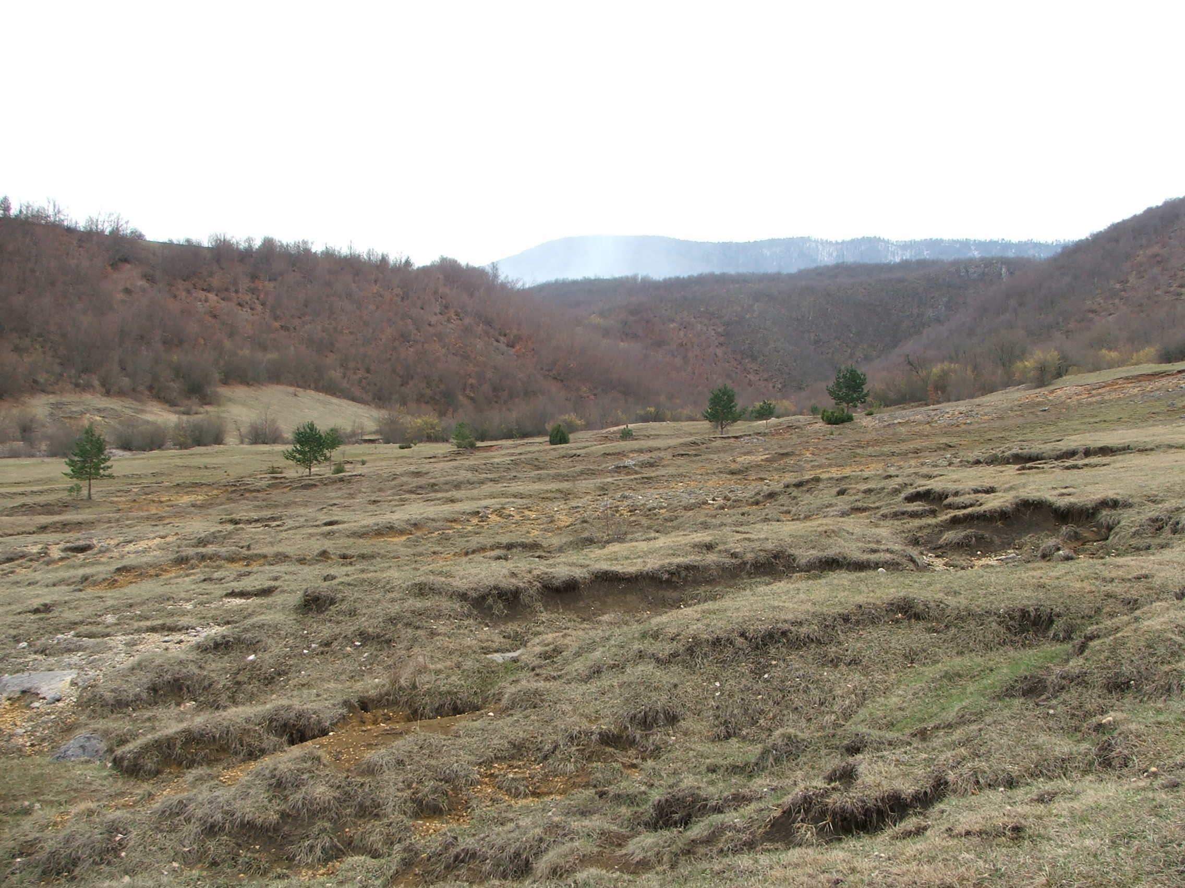

Slide 17
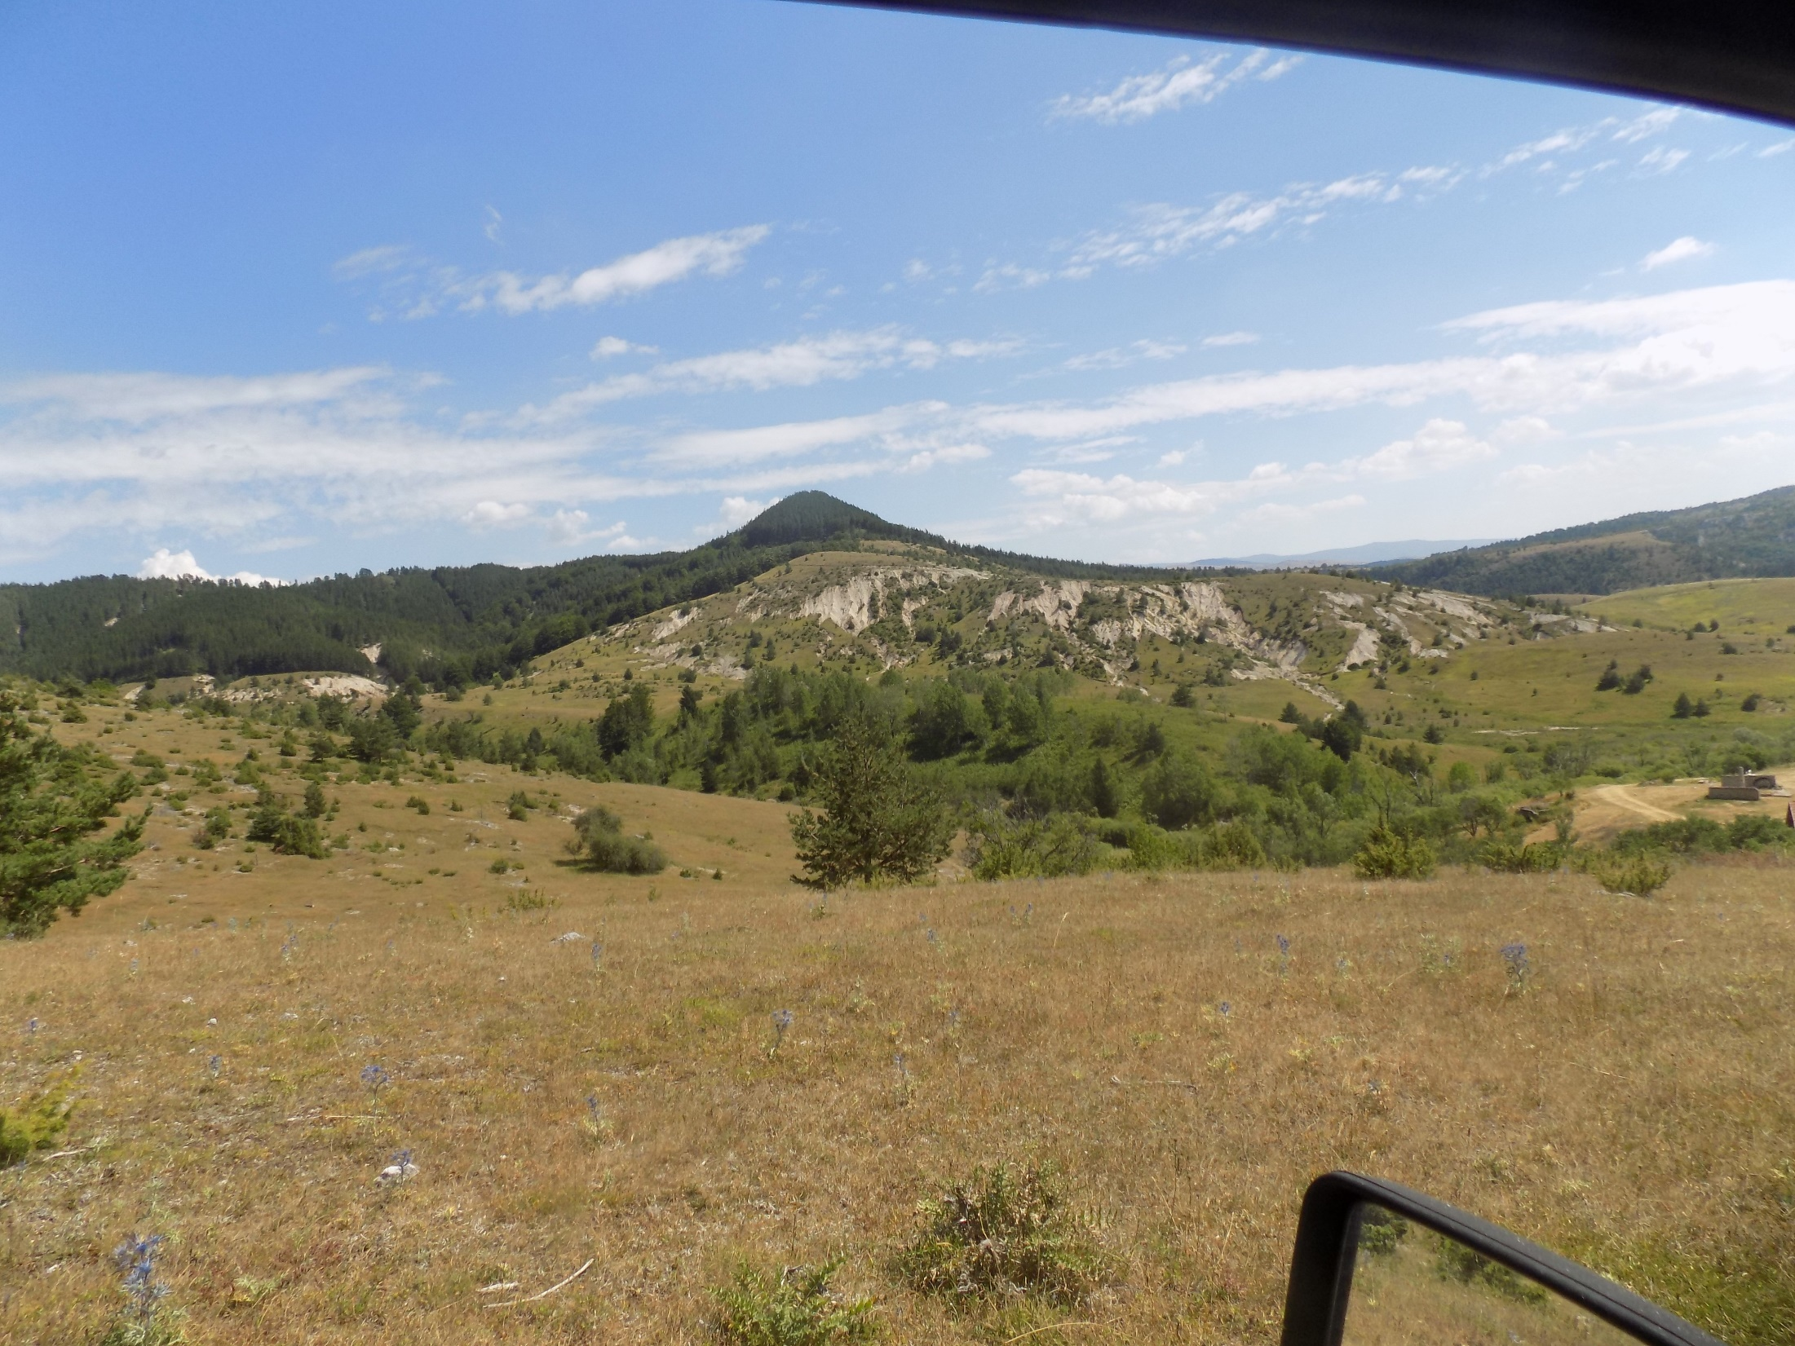

Slide 18
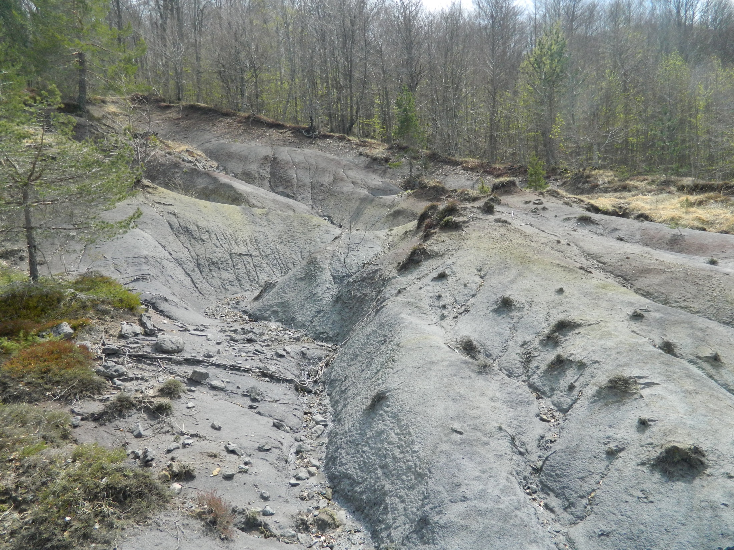

Slide 19
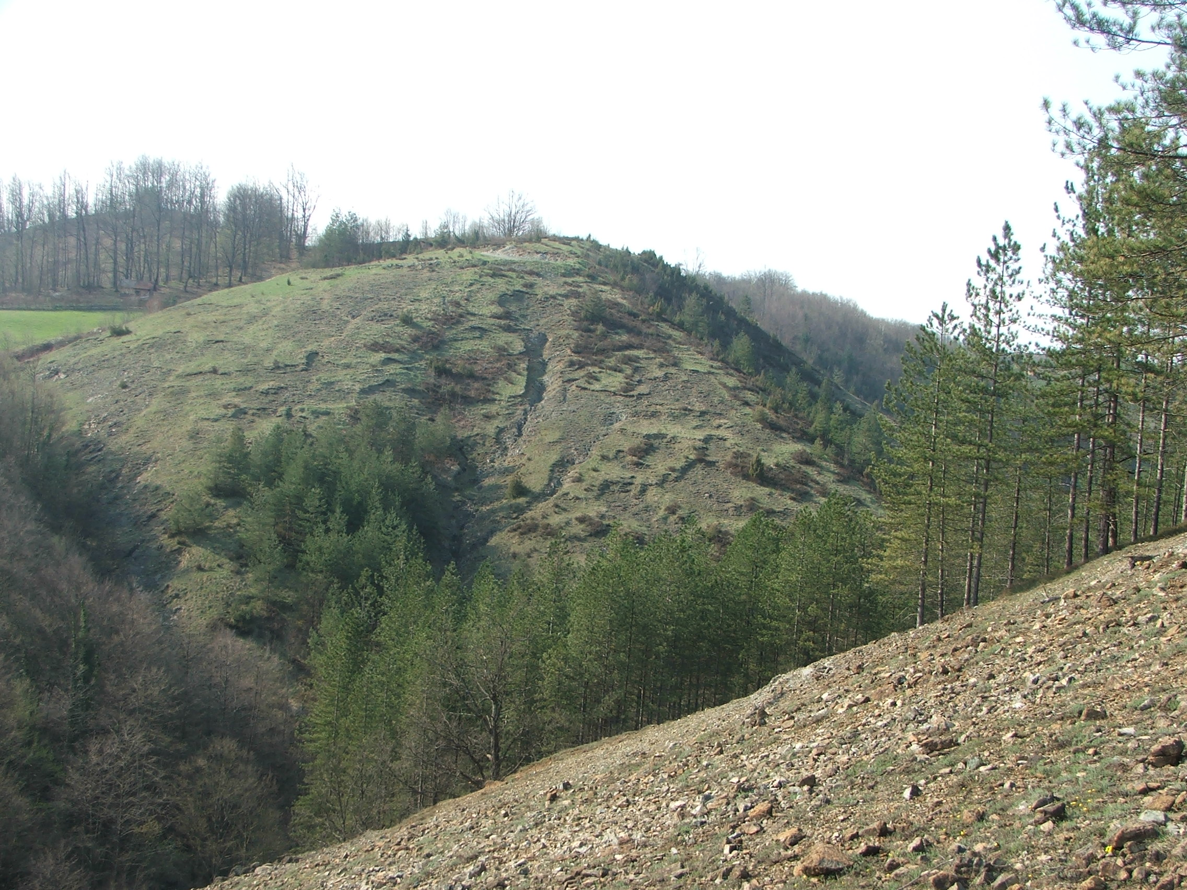

Slide 20
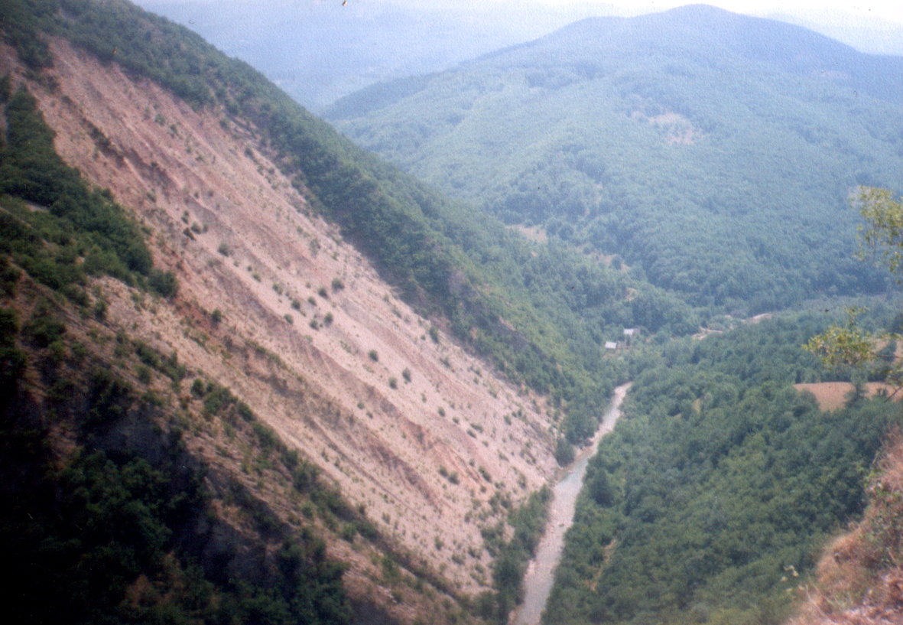

Slide 21
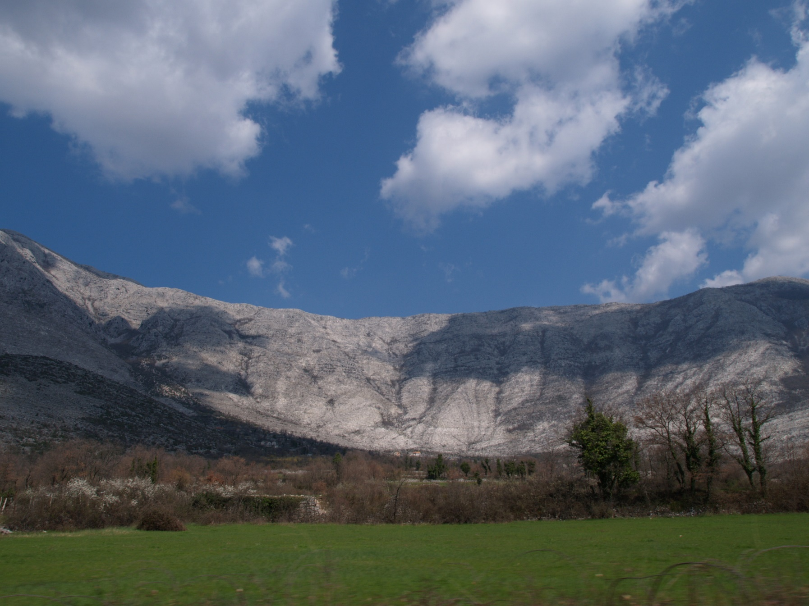

Slide 22
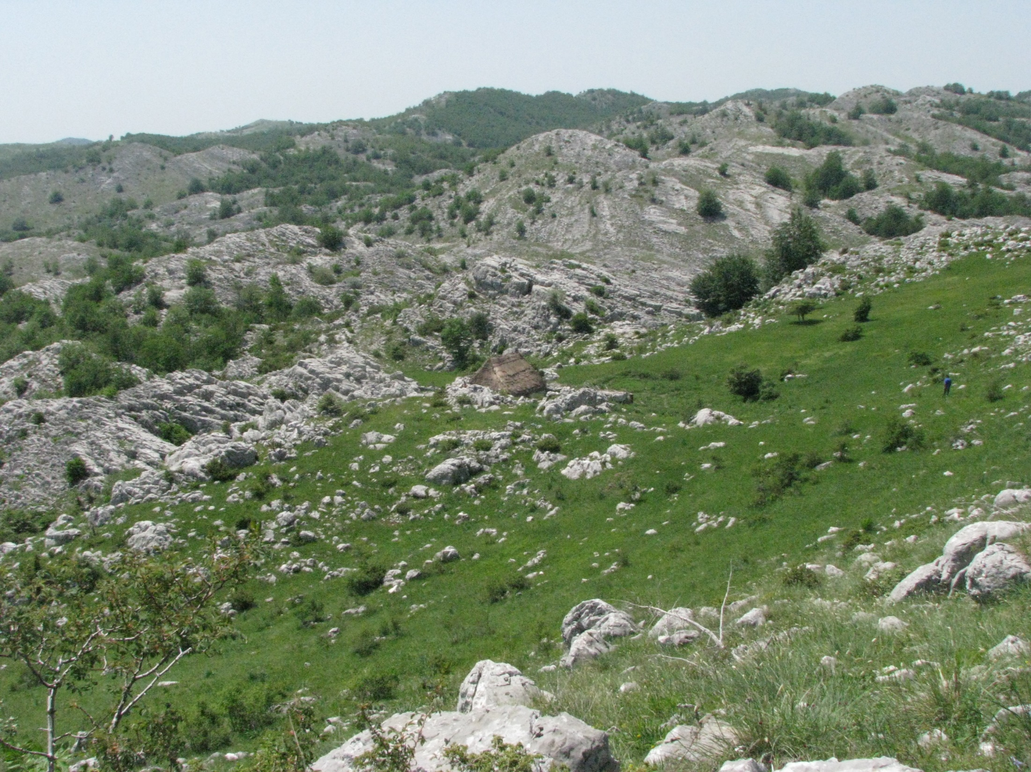

Slide 23
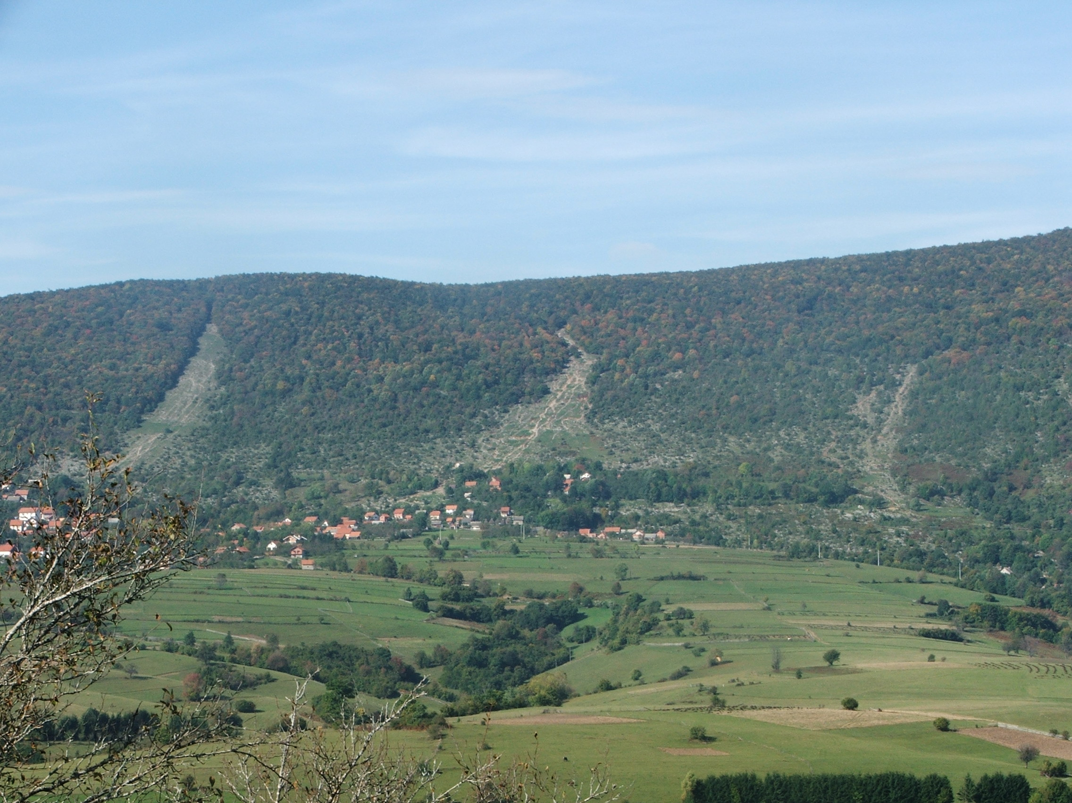

Slide 24
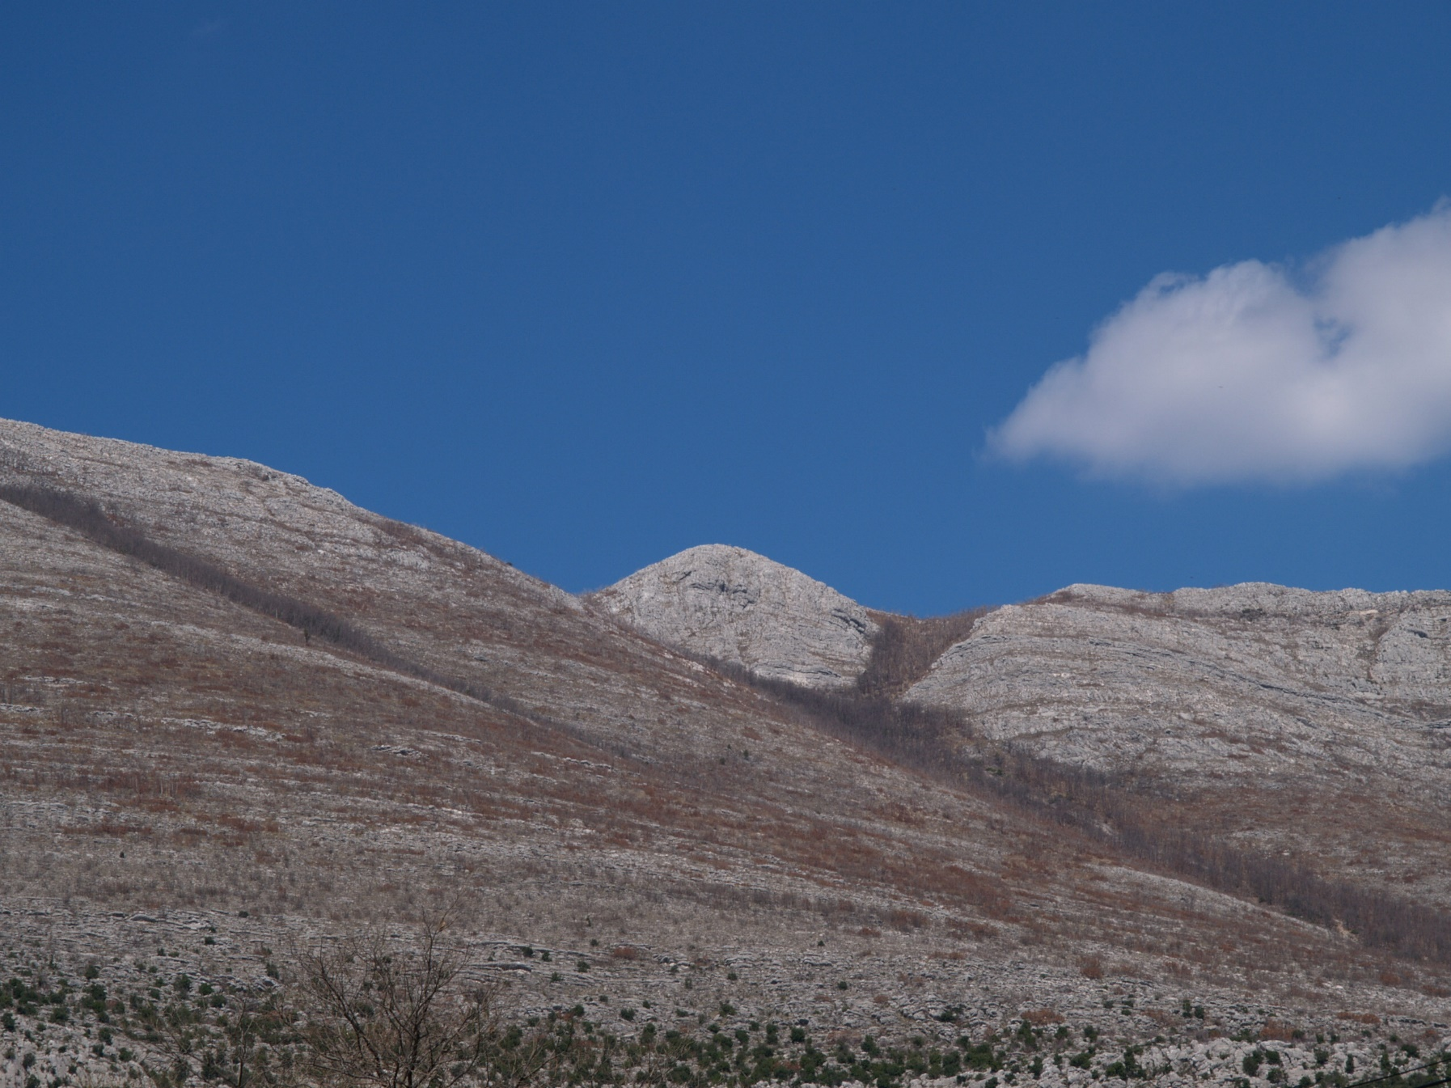

Slide 25
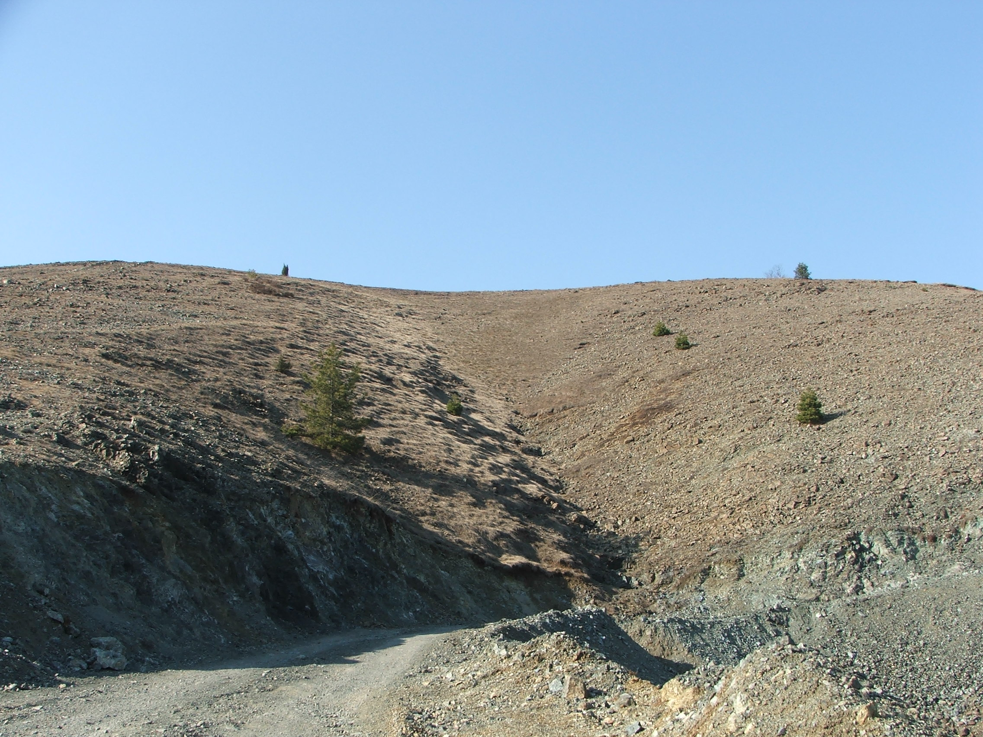

Slide 26
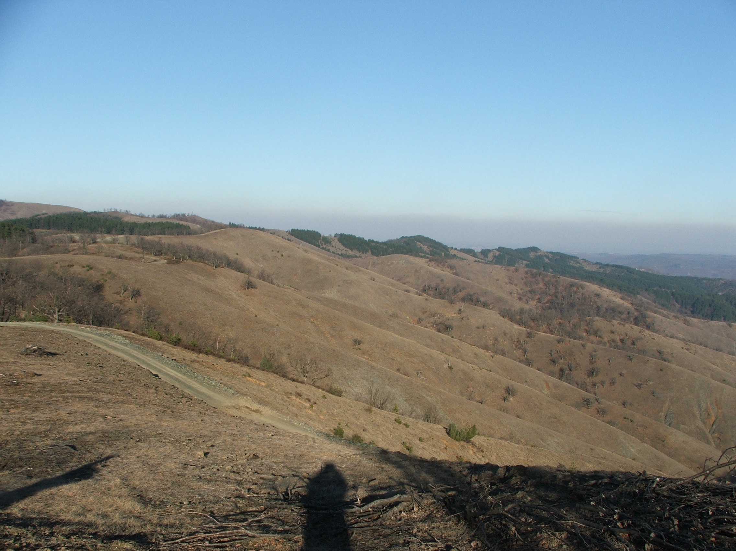

Slide 27
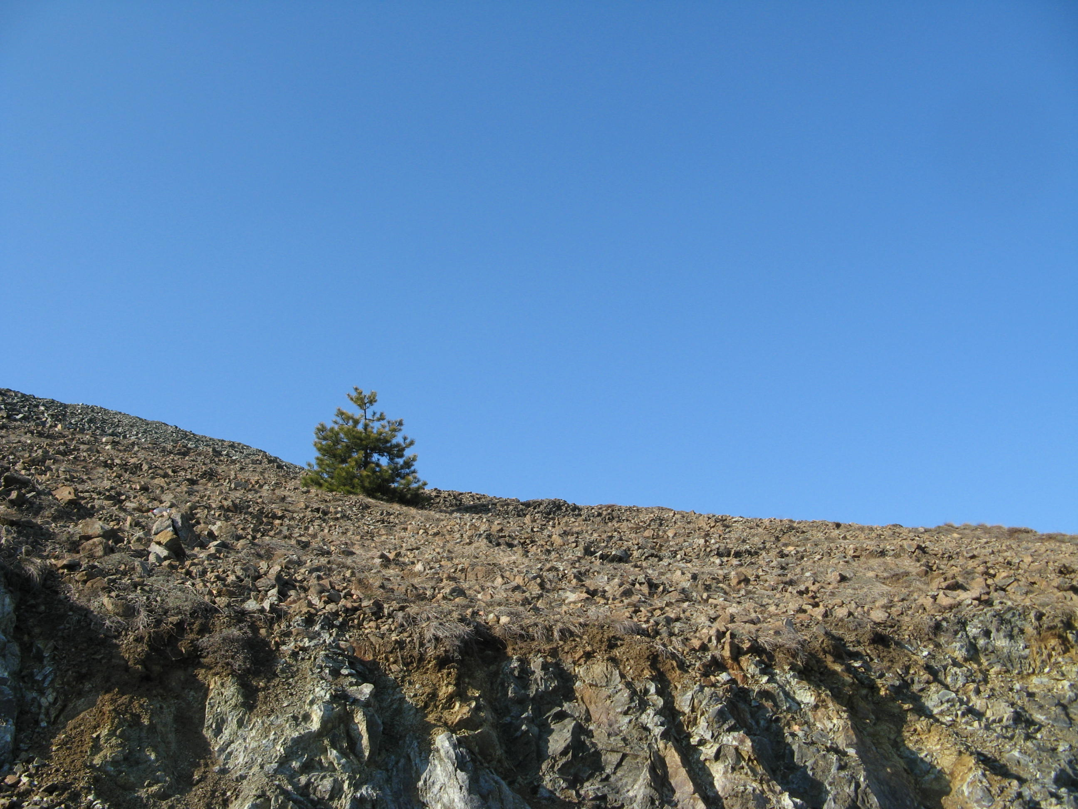

Slide 28
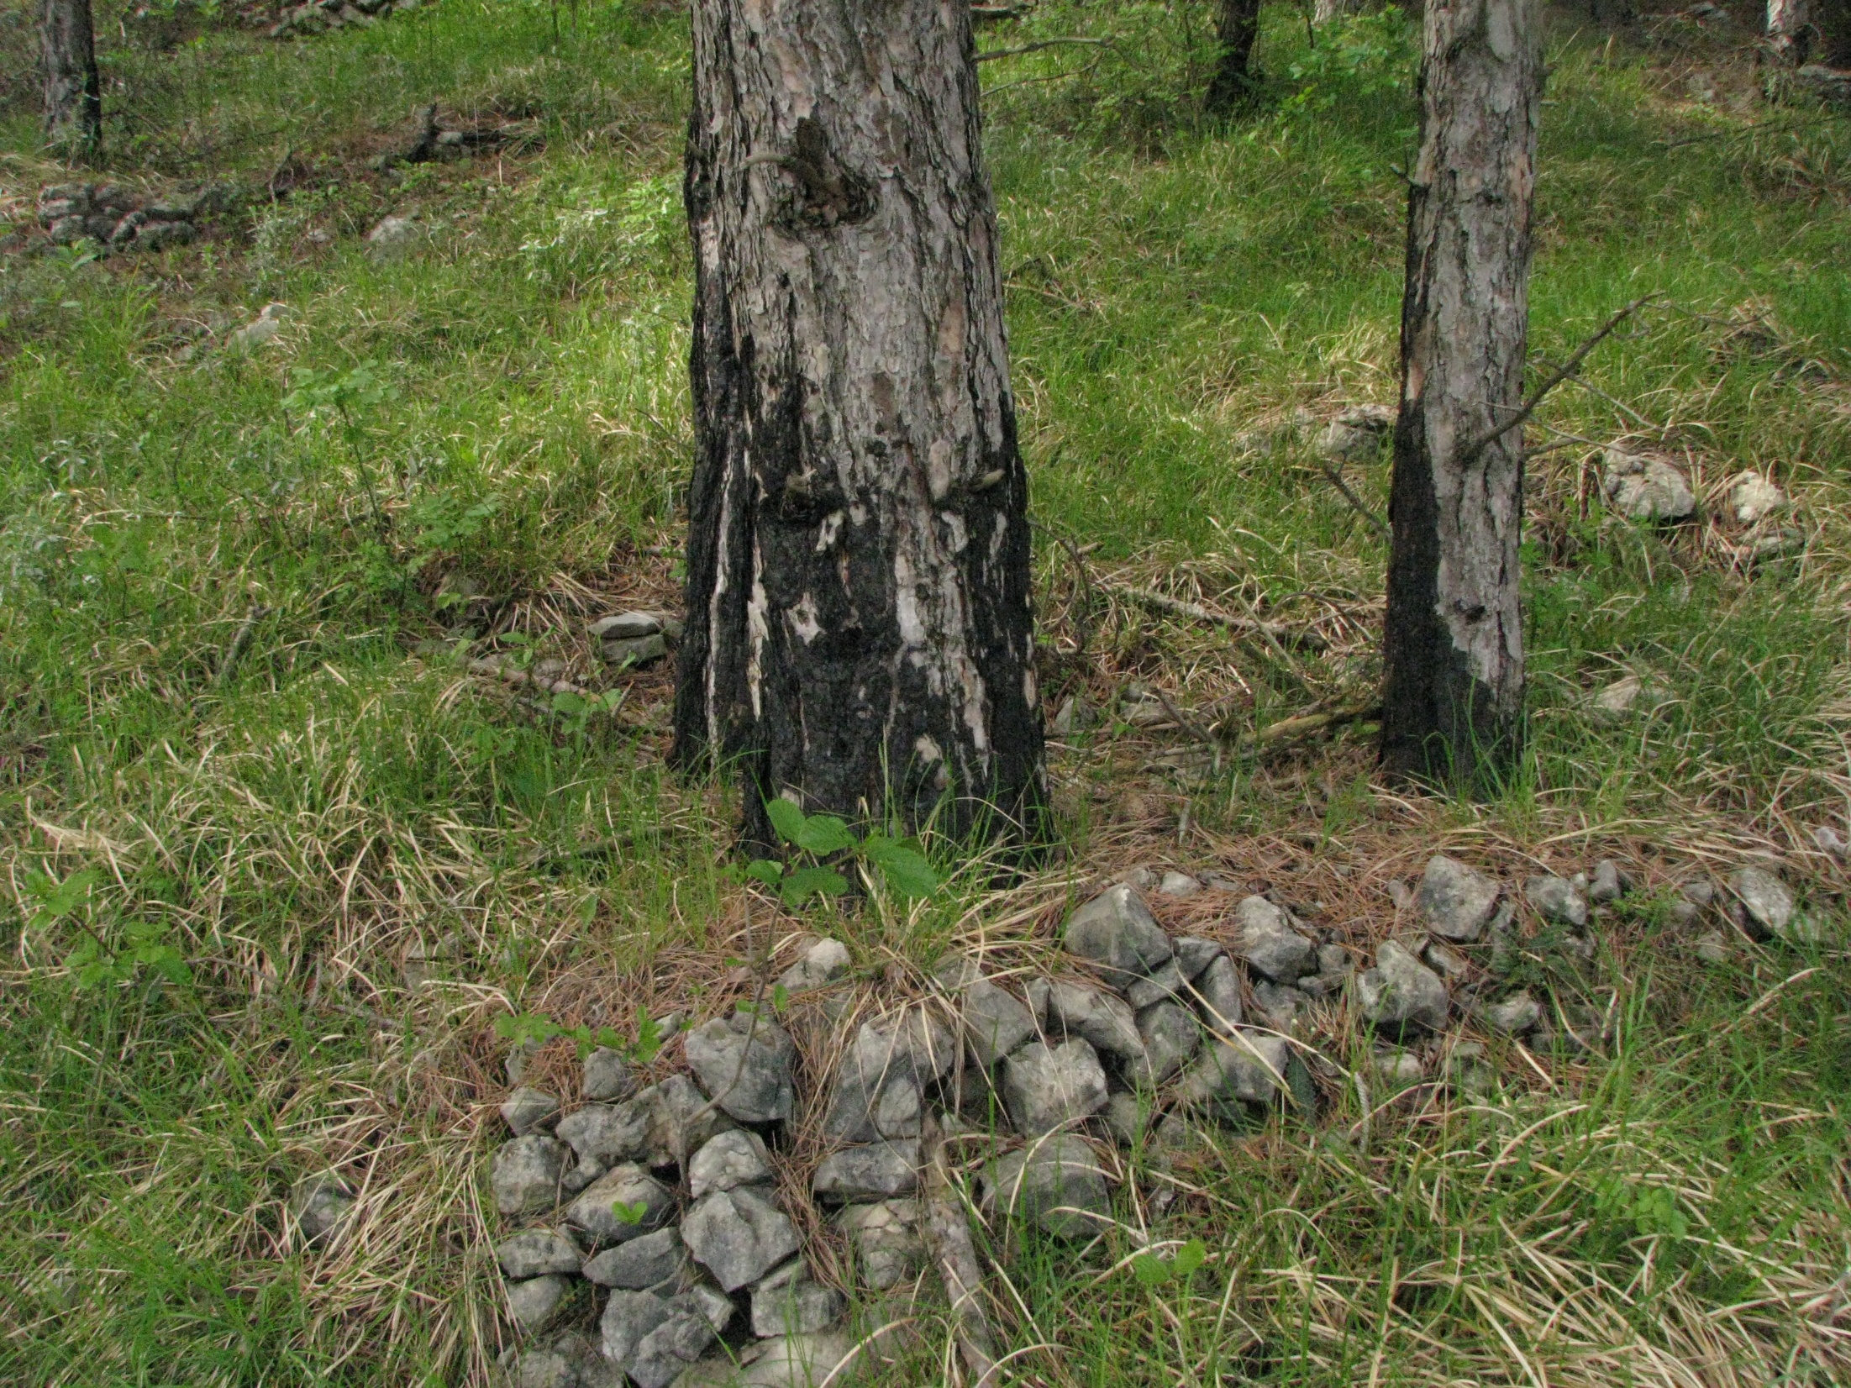

Slide 29
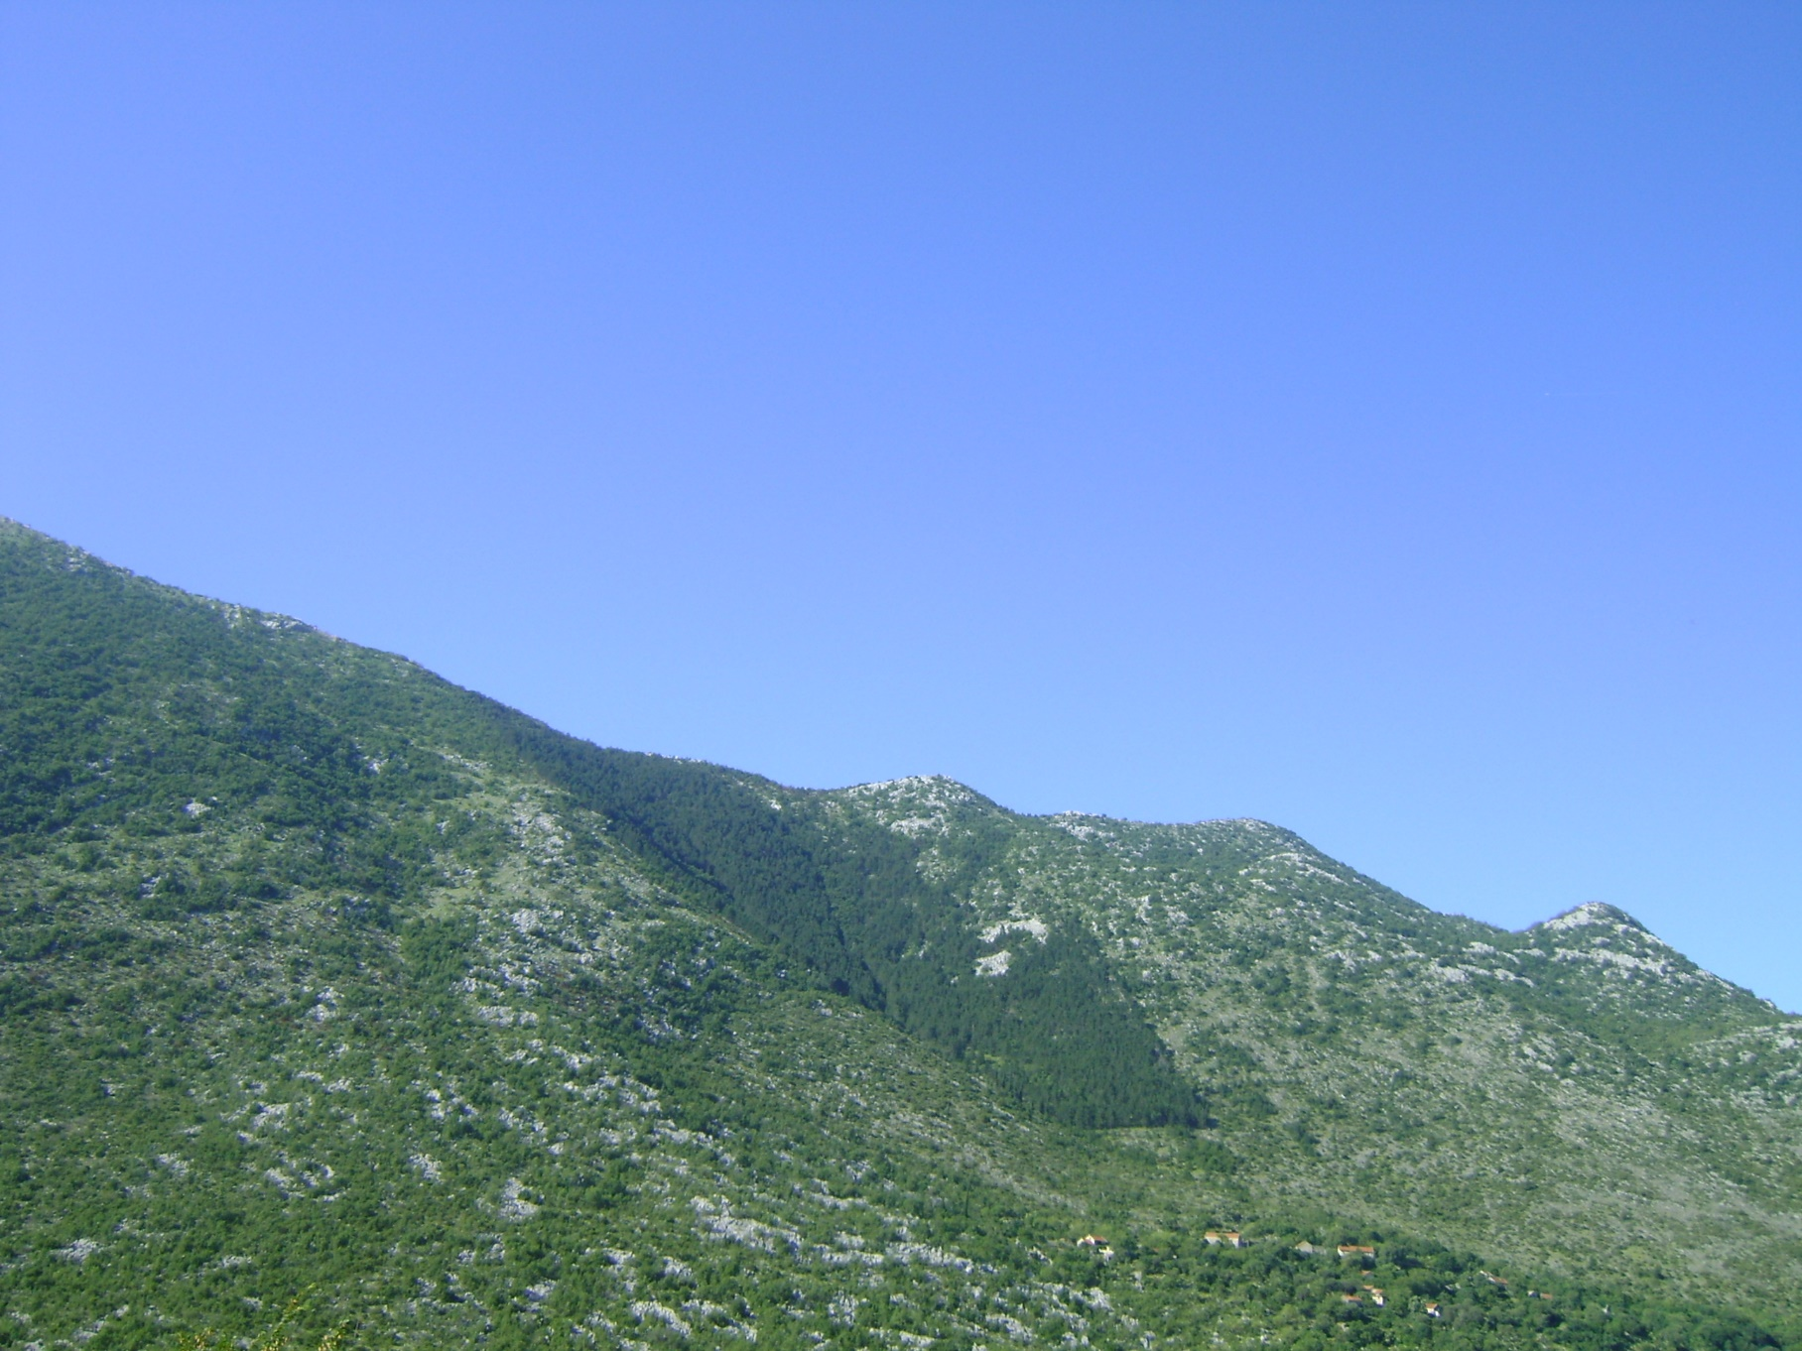

Slide 30
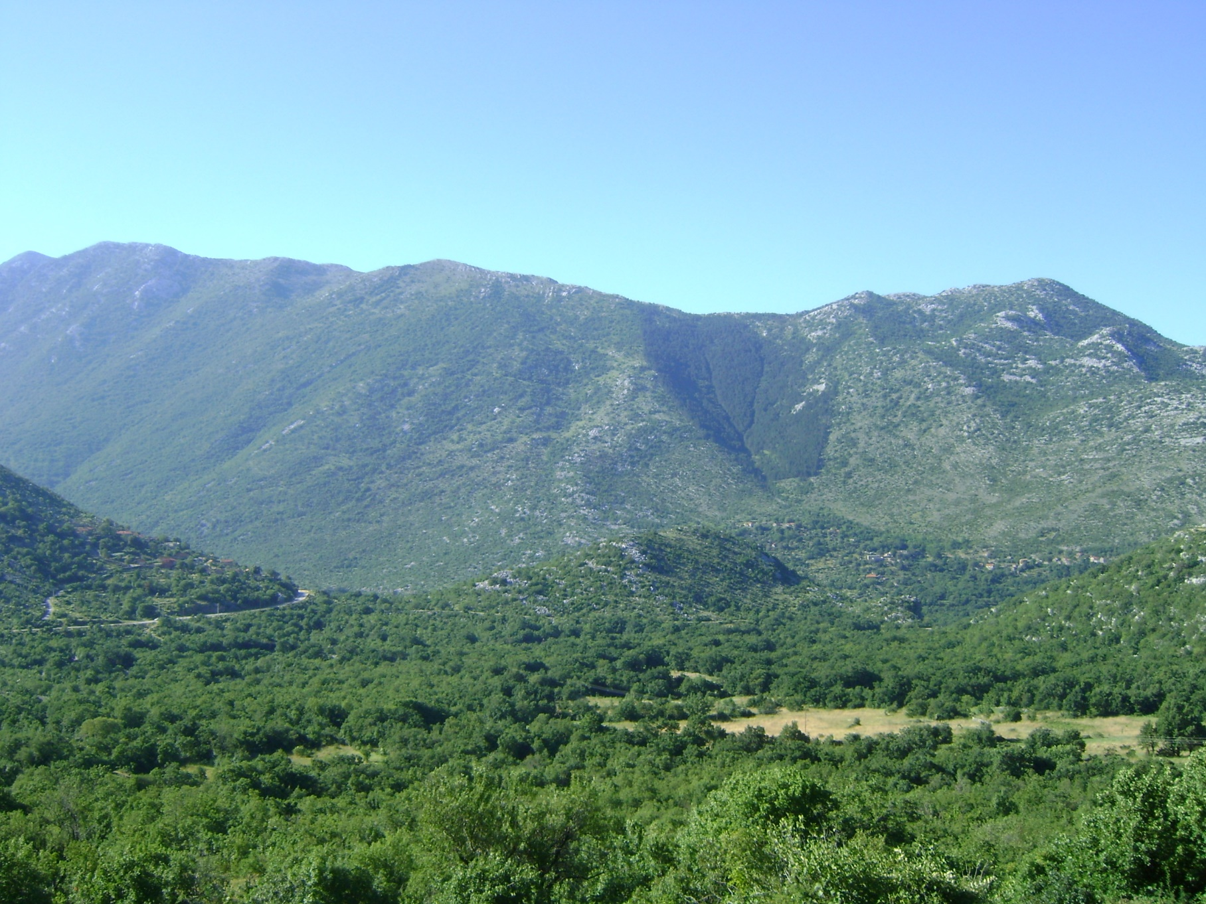

Slide 31
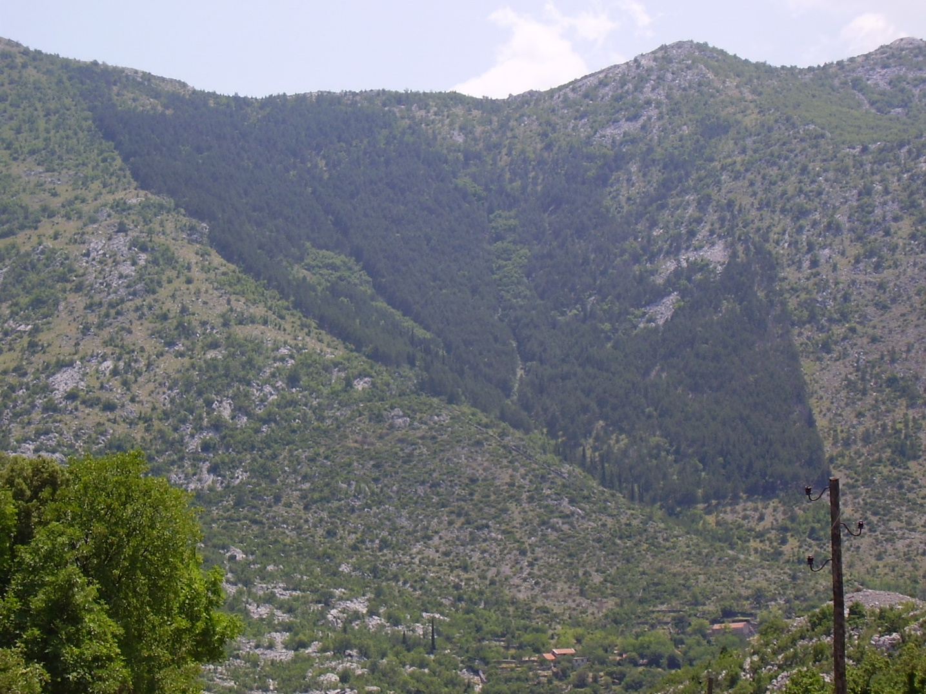

Slide 32
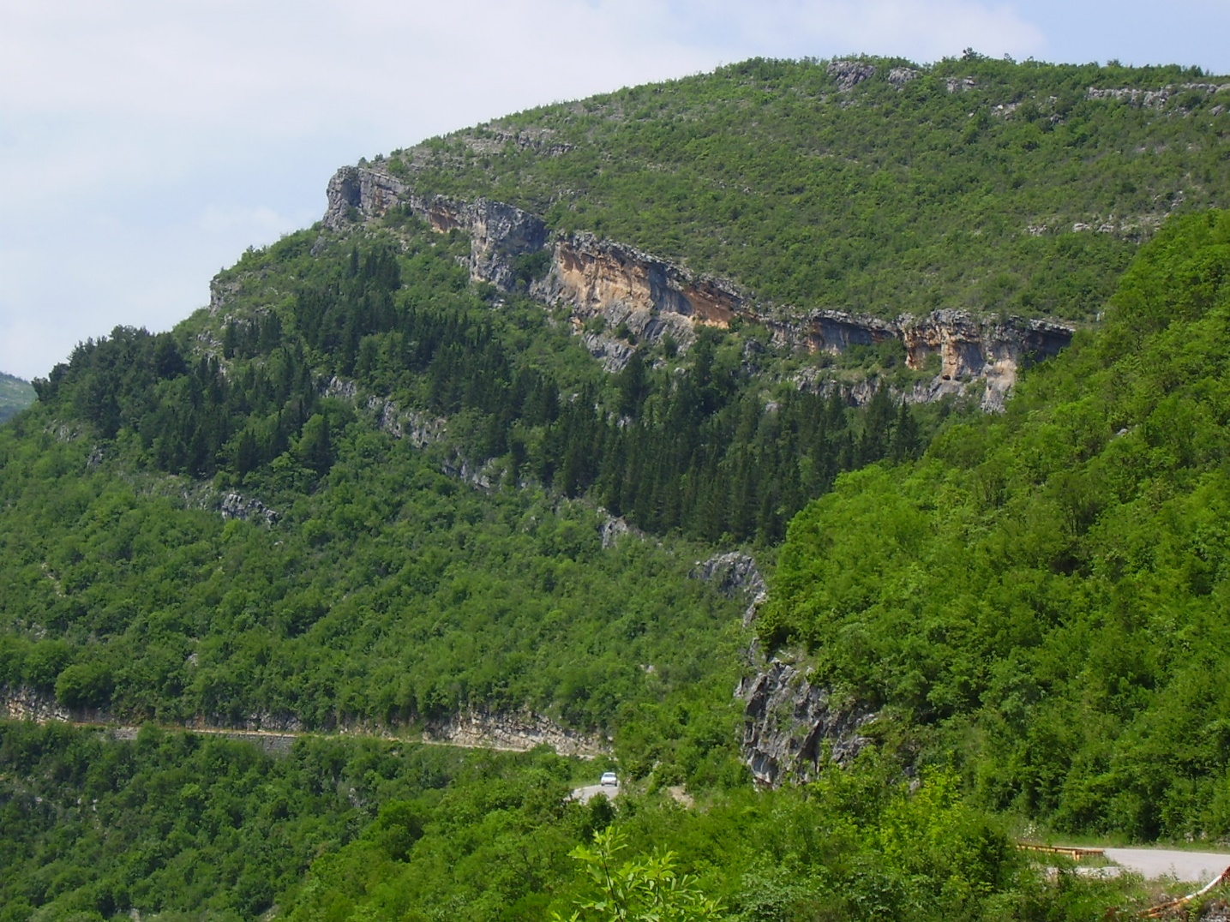

Slide 33
THANK YOU FOR ATTENTION!

