Slide 1
Overview of existing bachelor and master programme at the Faculty of Forestry UB
18-19 November 2019, Banja Luka

Slide 2
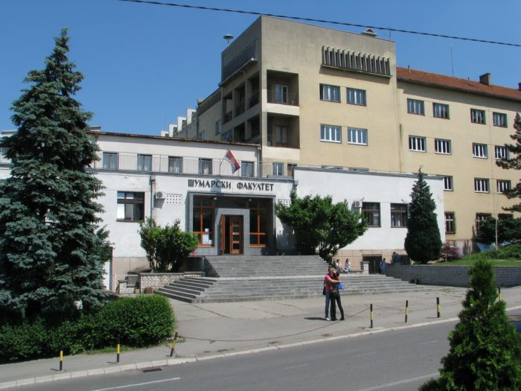
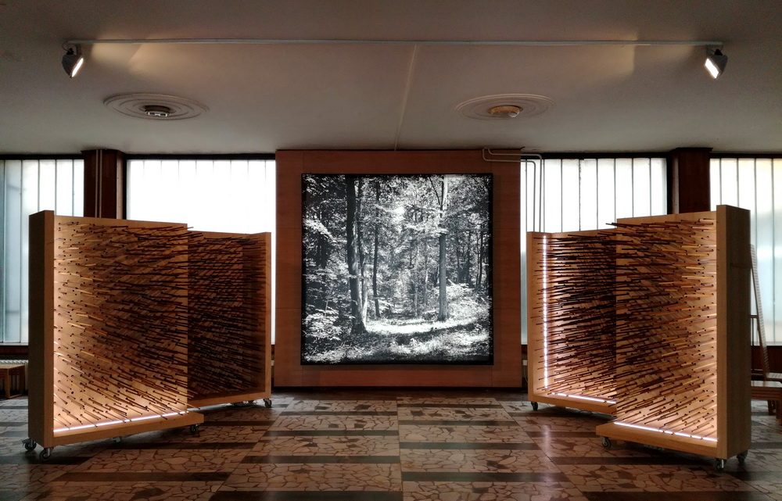
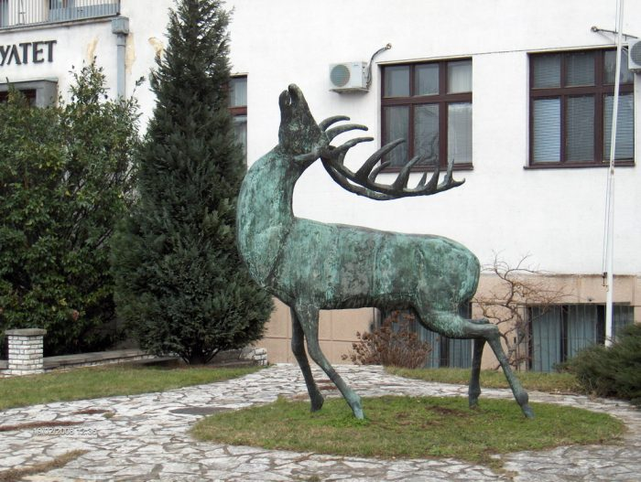
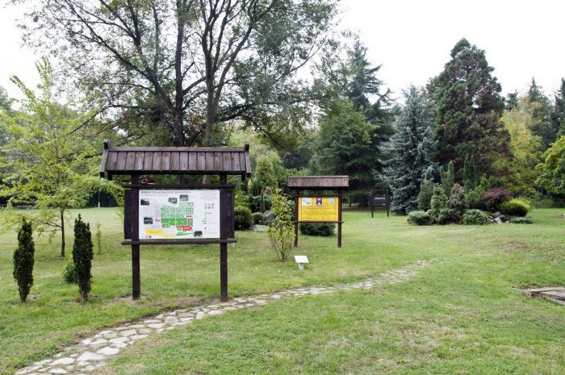
www.sfb.bg.ac.rs

Slide 3
History of the Faculty
After the termination of classes in agronomy, which were held at the Lyceum or the Great School (1868 god.) by Josif Pančić, the National Assembly has raised the question of the education of agricultural and forestry workers. As early as in 1870, the National Assembly discussed the draft law on the establishment of an agricultural school, whose task was to train people procurement clerks and foresters (district and county). This law was adopted on 24th October, 1870.
The First Regulation of the Faculty of Agriculture was adopted on 11th February 1921. Enrollment of students in the first semester was conducted in the academic year 1920/1921, and classes began on 5th December 1920. The first generation consisted of 45 enrolled students, of which 36 of the Department of Agriculture and 9 of the Department of Forestry.

Slide 4
After the II World war war teaching began in the academic year 1945/46. The subject “Torrent control” was taught by prof. Sreten Rosić.
In 1960, 5 departments were formed at the Faculty of Forestry, including the Department of erosion and torrent control. At the Department of erosion and torrent control the subjects were arranged in two chairs: the Chair of erosion and torrent control and the Chair of forest ameliorations.
In 1961 the Department changed its name to the Department of erosion control and ameliorations.
The new reorganization of the Faculty of Forestry was conducted in 1973. The Departments became institutes and all but forestry changed their names. The former Department of erosion control and ameliorations became the Institute for water management of erodible areas.
Significant changes in the organization of the Faculty of Forestry took place in 1988. The existing institutes were reorganized into departments and each department represented an educational profile of the Faculty. The Department then obtained the name Department for protection against erosion and its graduates received the title Graduate forestry engineer for protection against erosion.

Slide 5
After the adoption of the 2005 Law on Higher Education the Faculty adopted amendments to the Statute and new curricula for all educational profiles based on the principles of the Bologna Declaration. One significant change was the new name of the Department, which remained to date – the Department of Ecological engineering for soil and water resources protection.

Slide 7
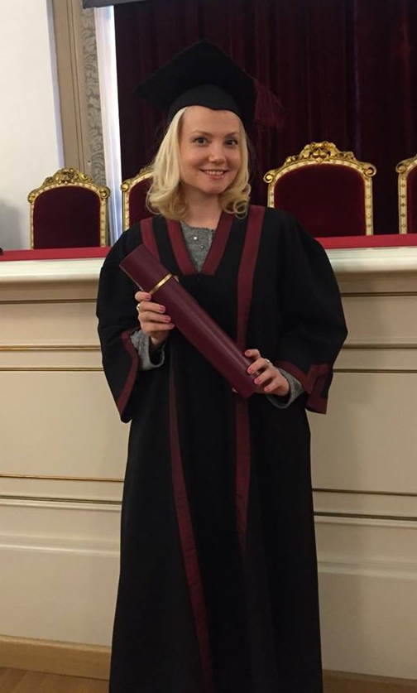
Bachelor degree
1.
240 ECTS
4 years
Master degree
2.
60 ECTS
1 year
PHD
3.
180 ECTS
3 years
Forestry
Wood Science and Technology
Ecological engineering for soil and water resources protection
Landscape architecture
University of Belgrade,
Faculty of Forestry

Slide 8
Undergraduate studies (Bachelor) in Faculty of Forestry
The first level of studies (Bachelor) are undergraduate studies. This level is relevant primarily for the labor market. At the first level of the studies within the first study cycle, the students not only acquire theoretical knowledge, but sufficient competencies, both general and professional, which enable them to continue studying at the next study level.

Slide 9
Study programs of undergraduate studies last for 4 years, after which the students obtain 240 ECTS and the professional titles:
Graduate forest engineer – students who graduate from the study program Forestry
Graduate engineer of technologies, management and design of furniture and wood products – students who graduate from the study program Technologies, management and design of furniture and wood products
Graduate engineer of landscape architecture – students who graduate from the study program Landscape architecture
Graduate forest engineer – students who graduate from the study program Ecological engineering for soil and water resources protection.

Slide 10
Ecological engineering for soil and water resources protection
Undergraduate study program

Slide 11
I year

Slide 12
II year

Slide 13
III year

Slide 14
IV year

Slide 15
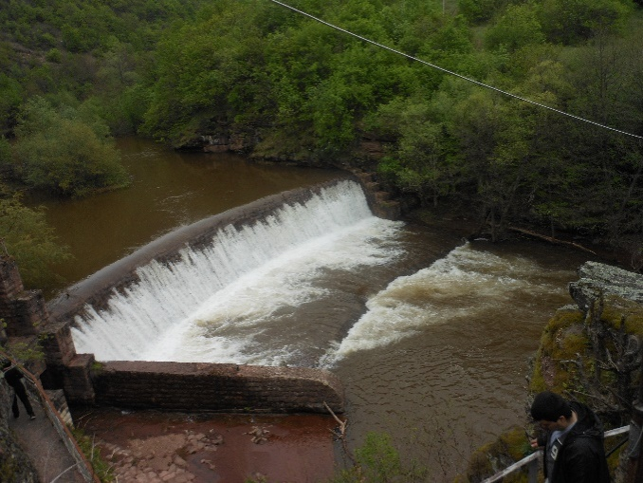
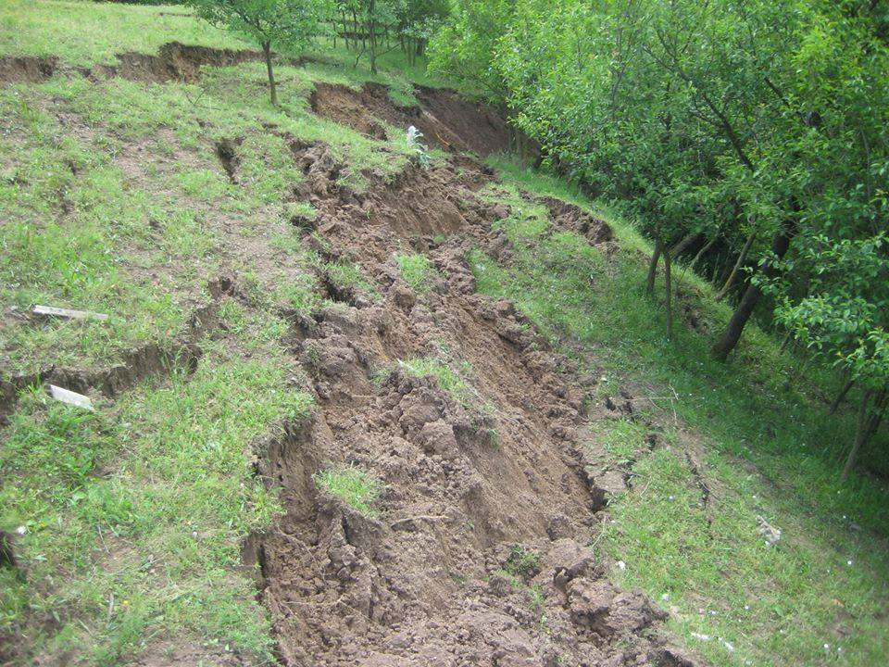
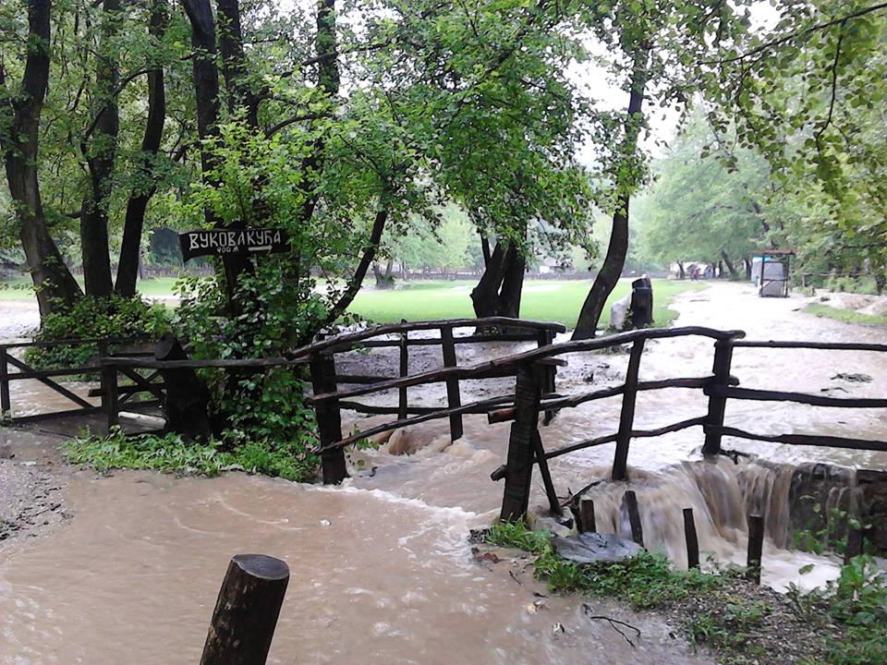
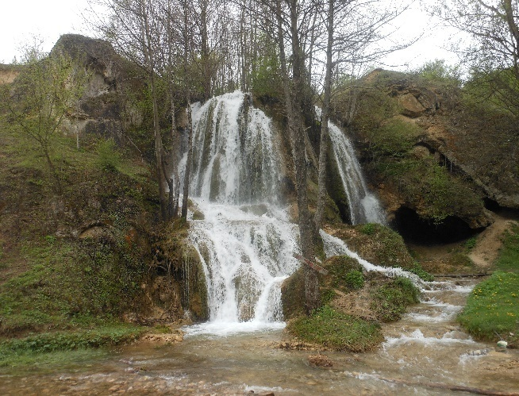
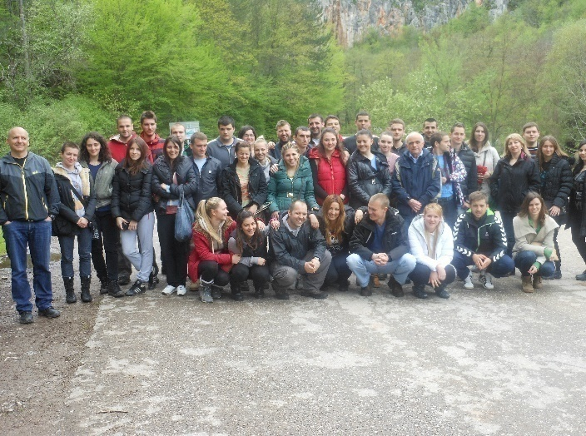
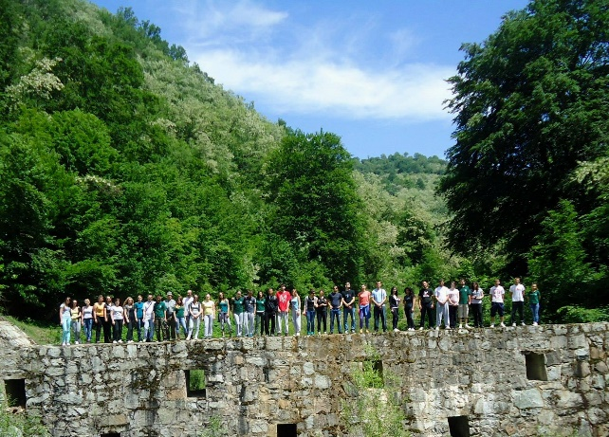
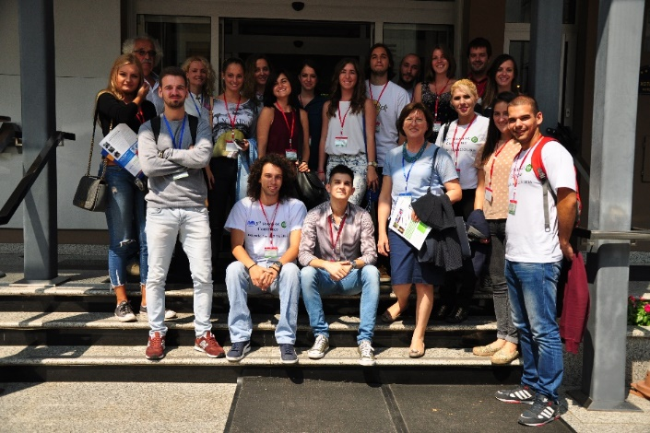
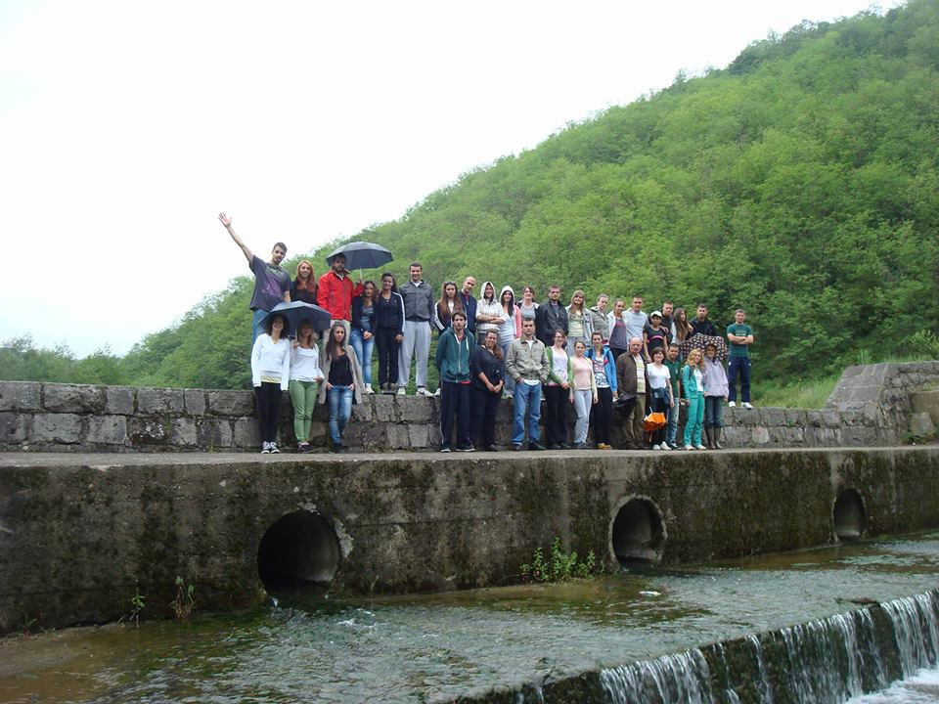

Slide 16
Ecological engineering for soil and water resources protection
Master degree study
The study program of master degree study lasts for one year (2 terms) and the students obtain 60 ECTS upon graduation

Slide 17
M1 – Protection of water resources in hilly-mountainous areas

Slide 18
M2 – Degradation and protection of soil resources

Slide 19
M3 – Management of sustainable development in degraded areas

Slide 20
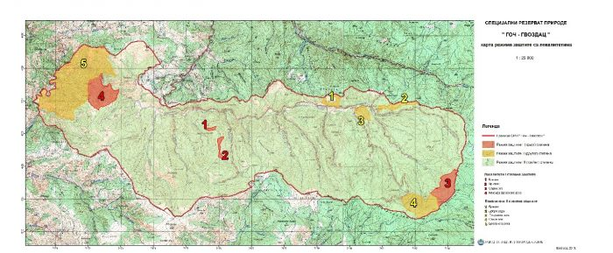
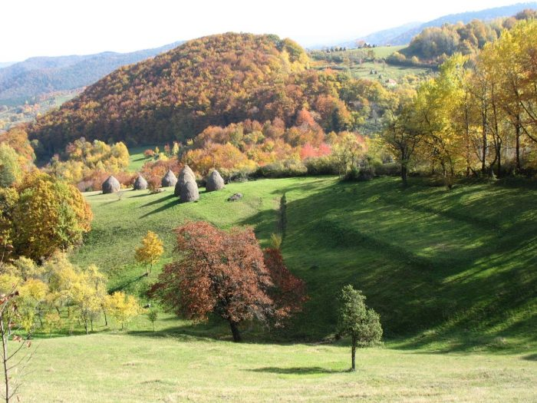
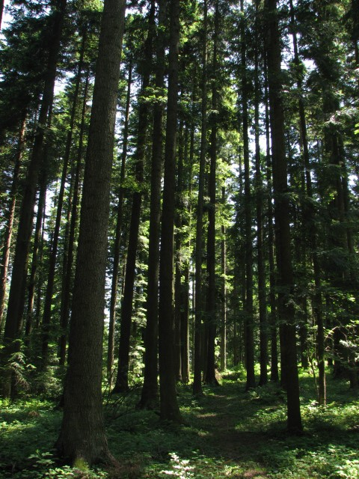
Teaching base „GOČ- GVOZDAC“

Slide 21
International cooperation
Тhe Faculty has intensified work in the field of cooperation with universities from Europe, Asia, colleges and institutes from the region:
European Forestry Institute from Finland, the Norwegian Forestry Group (NFG) from Norway, the Faculty of Forestry Moscow State University from Russia, the Faculty of Forestry of the University of St. Cyril and Methodius in Skopje from Macedonia, the Faculty of Biotechnology of the University of Ljubljana from Slovenia, the University of Natural Resources and Life Sciences (BOKU) – Department of Civil Engineering and Natural Hazards from Austria, the Institute of Soil and Water Conservation from China, Albert Ludwigs University from Freiburg, Technical-Technology University in Brno and Mendel University in Brno from Czech Republic, Ohio State University, Columbus, Ohio, USA; Kazan State University, Environmental Dept., Kazan, Russia; Lomonosov University, Geography Dept., Moscow, Russia; Czech University of Agriculture Prague, Faculty of Forestry.

Slide 22
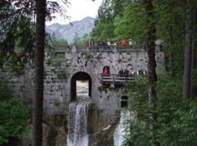
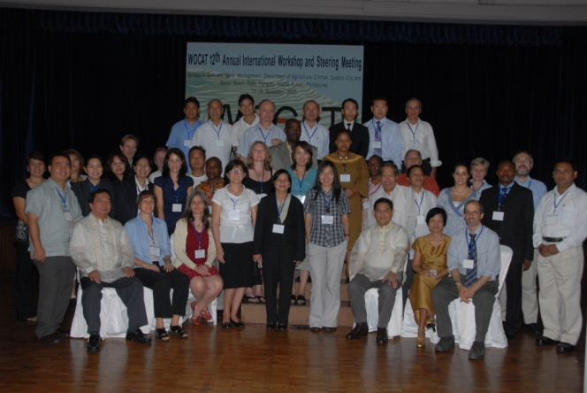
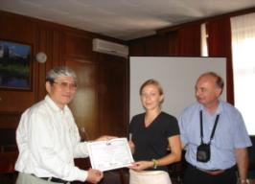
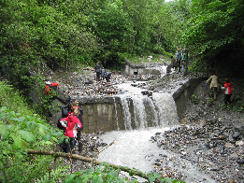
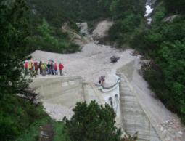
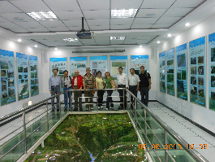
Study visits
International cooperation

Slide 23
International cooperation
CDE ‒ Center for Development and Environment, Berne University, Switzerland;
ISWC ‒ Institute of Soil and Water Conservation, CAS&MWR, Yangling, Shaanxi, China;
College of International Education, Northwest A&F UniversityYangling, Shaanxi, China;
IRTCES ‒ International Research and Training Center on Erosion and Sedimentation, Beijing, China
Soil Conservation Society of India, New Delhi, India;
Soil and Water Conservation Research and Development Division, Land Development Department, Jatuchak, Bangkok, Thailand;
Climate Change Affecting Land Use in Mekong Delta, Institute Los Banos, Laguna, Manila, Phillippines;
Dipartimento di Scienze Agrarie e Forestali ‒ Università di Palermo, Italy;
Oxford Brookes University, Geography & University Teaching Fellow;
Lleida University, Lleida, Spain;
Centro de Investigaciones sobre Desertificación ‒ CIDE, (CSIC,Universitat de Valencia, Generalitat Valenciana), Spain;
ISRIC ‒ World Soil Information, Wageningen University, Holland;

